Slide 1
Results

Slide 2
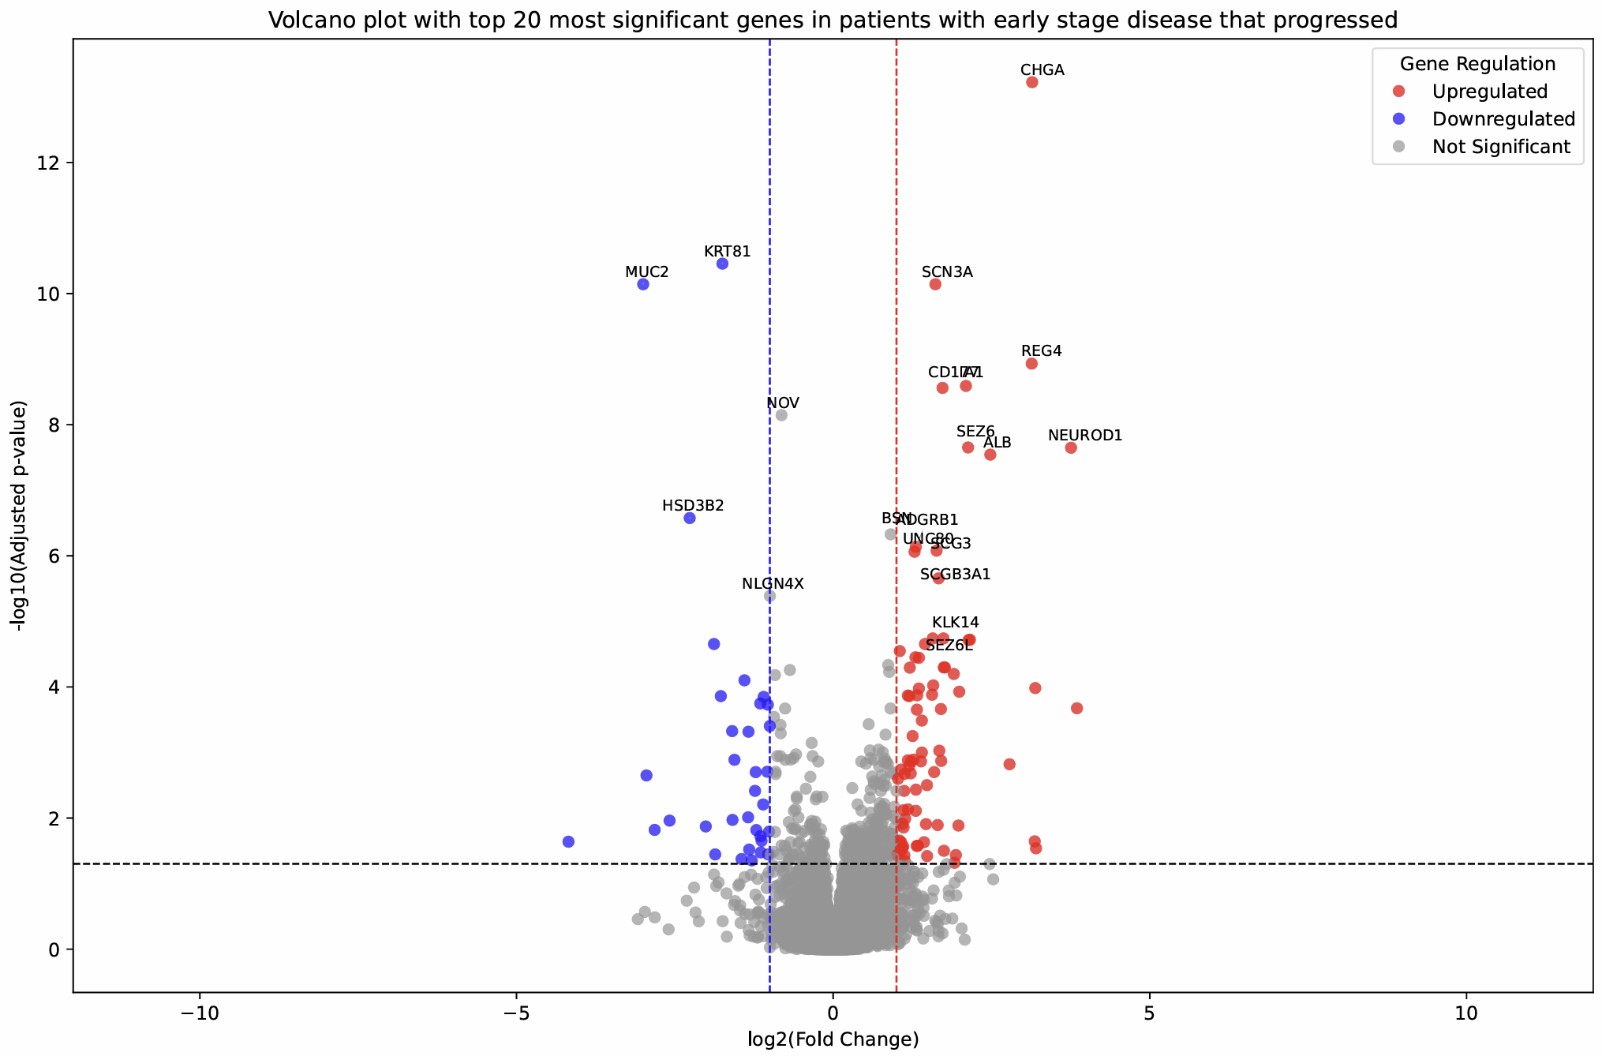
Dfs early-stage volcano
Notes:
- No

Slide 3
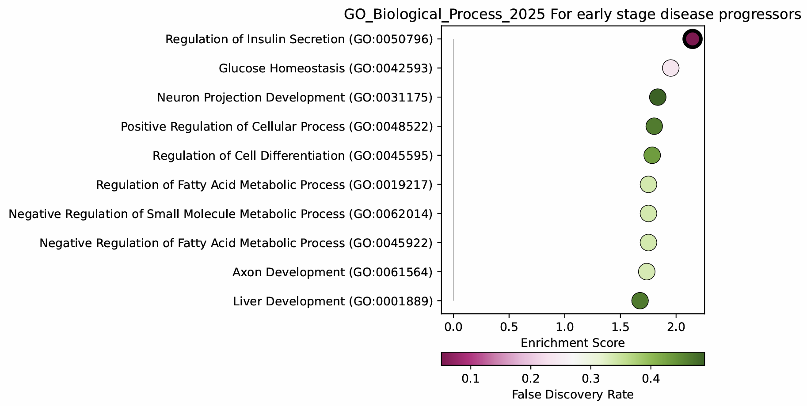
Dfs early-stage GO_bp GSEA
Notes:
- Yes to figure

Slide 4
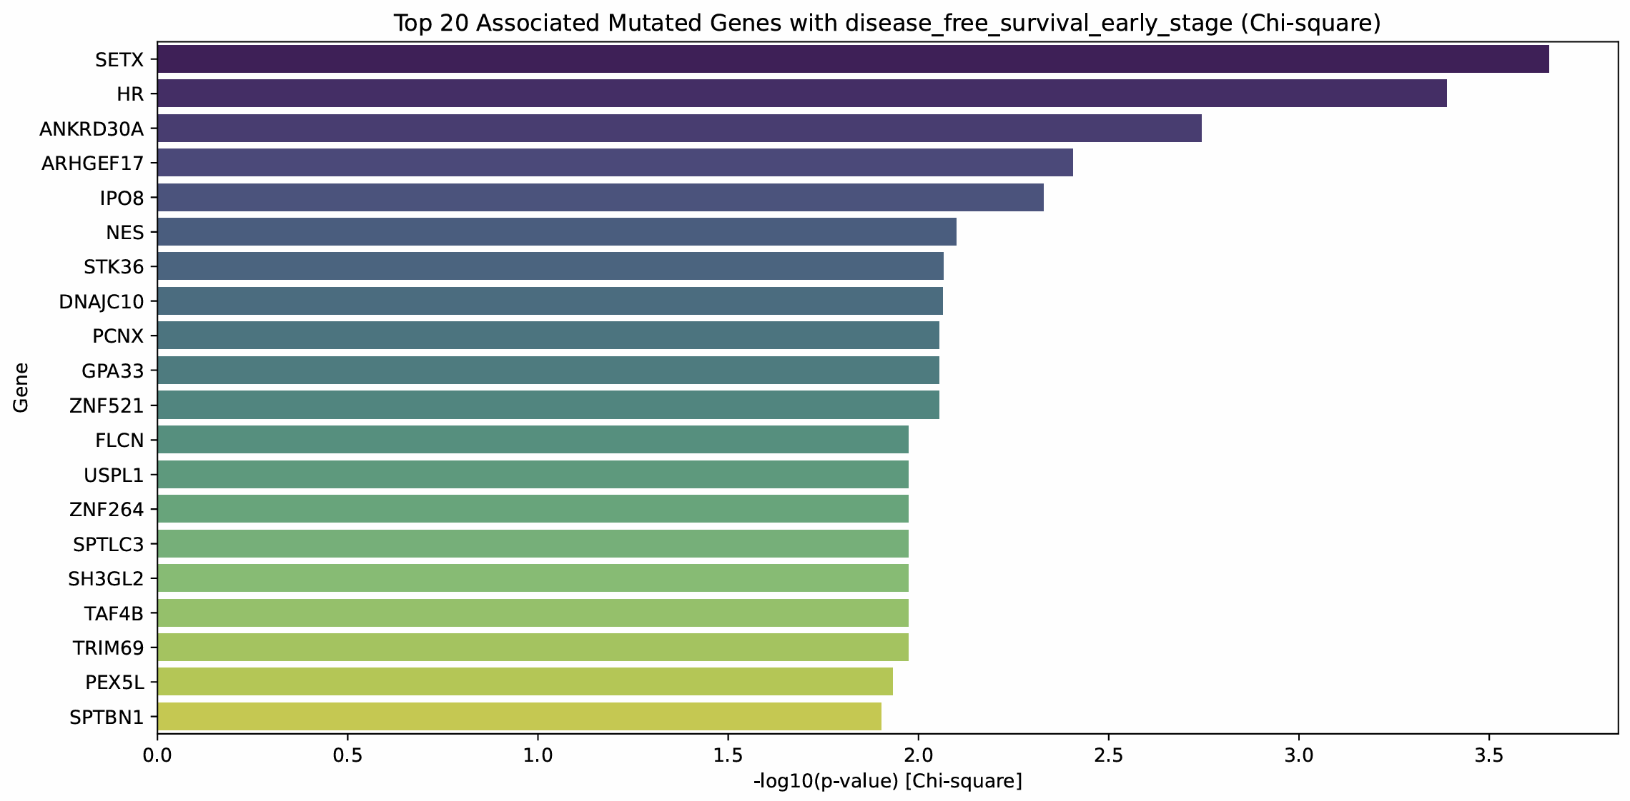
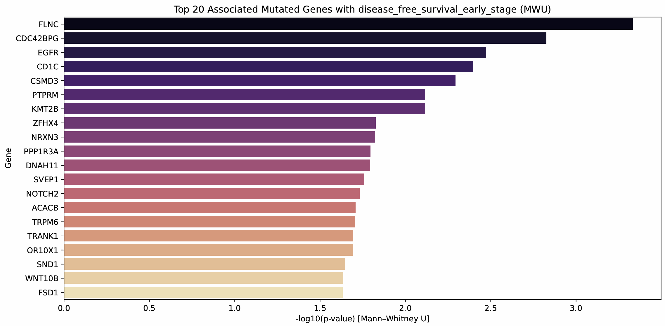
Dfs early-stage co-mutations
Notes:
- Yes to appendix

Slide 5
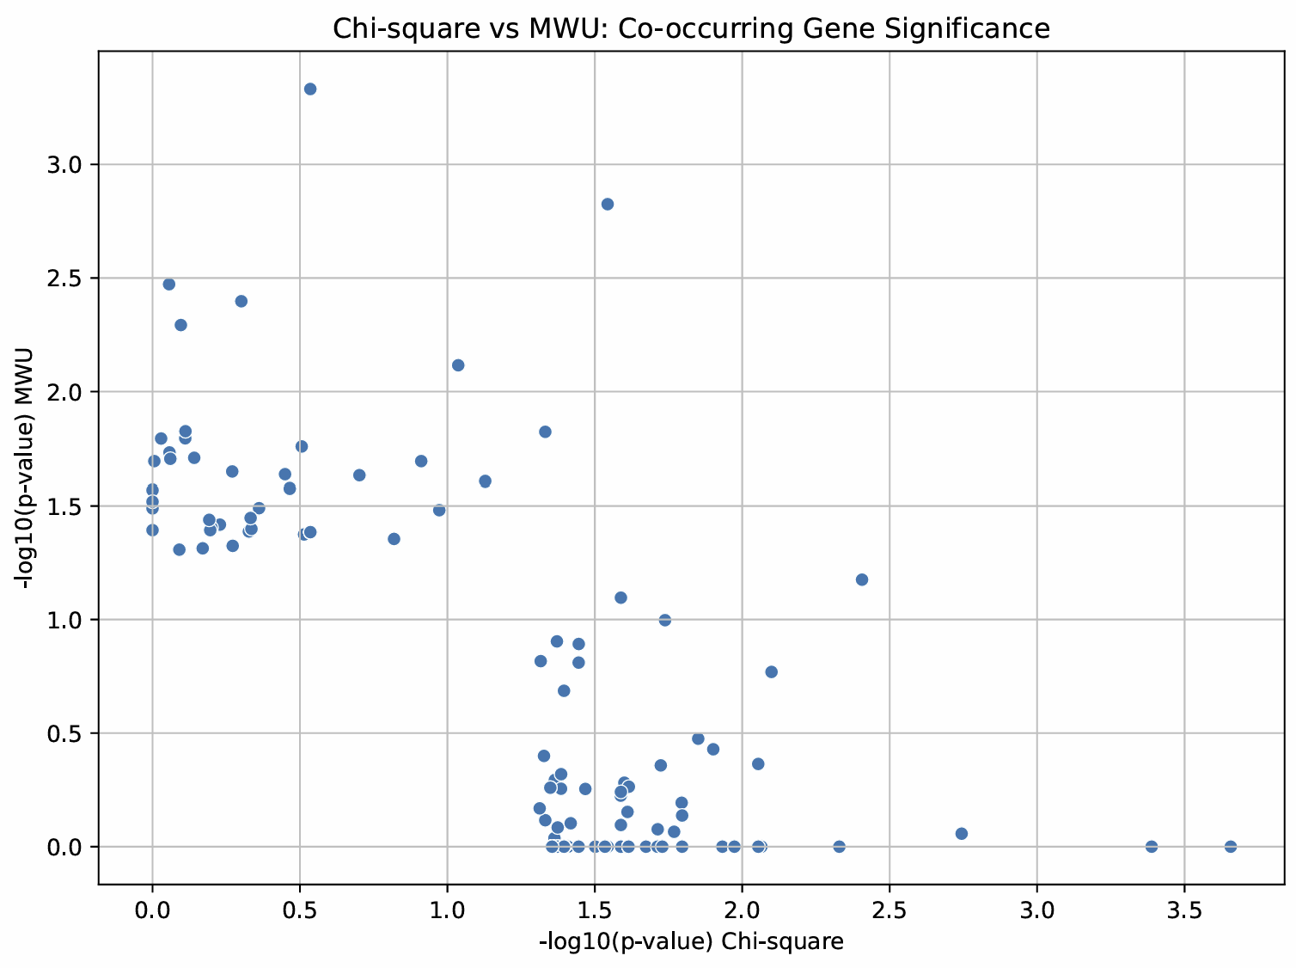
Dfs early-stage co-mutation scatter
Notes:
- No

Slide 6
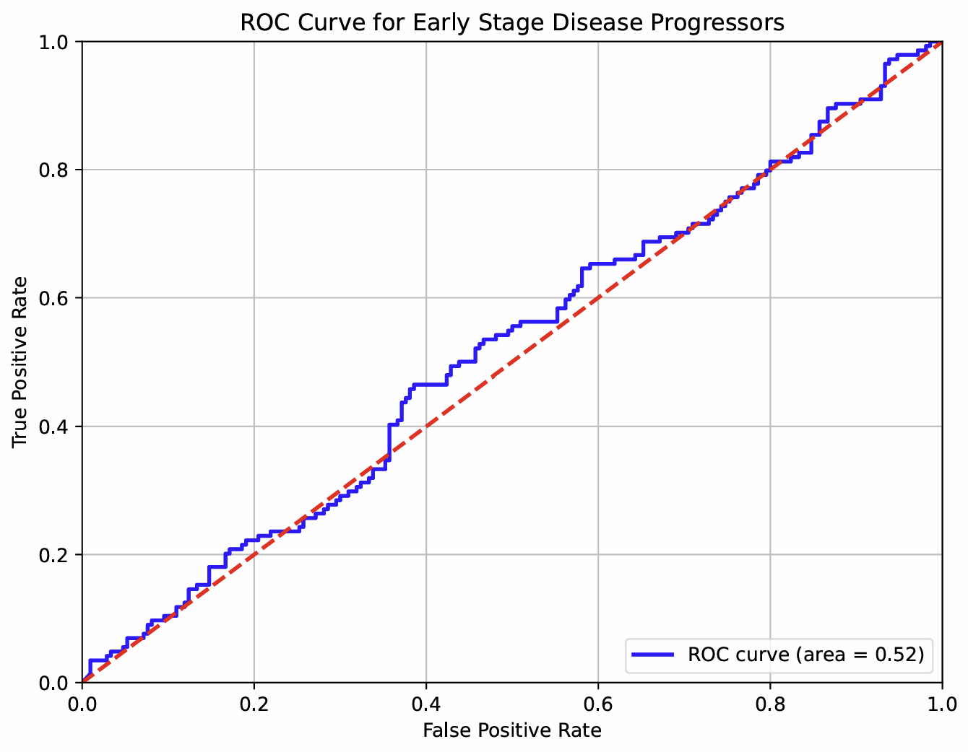
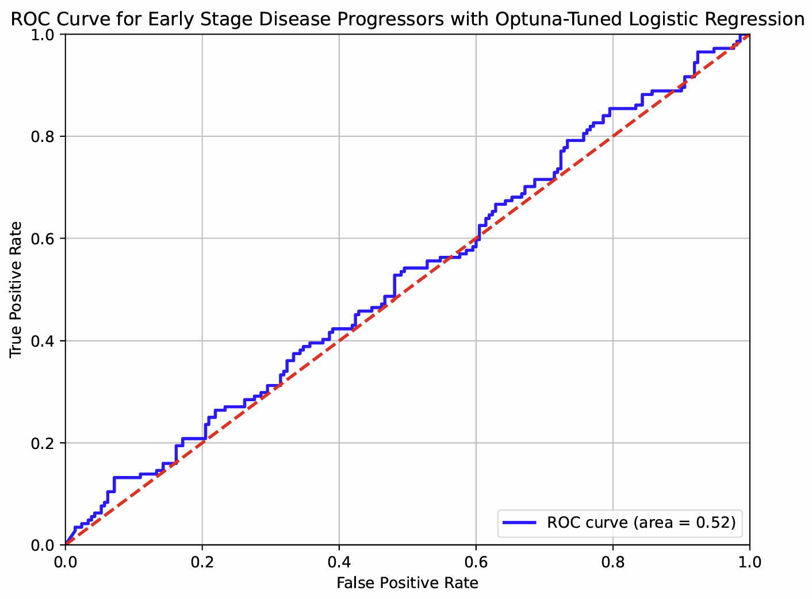
Dfs early-stage roc curve
Notes:
- Table for all AUC, only show good curves

Slide 7
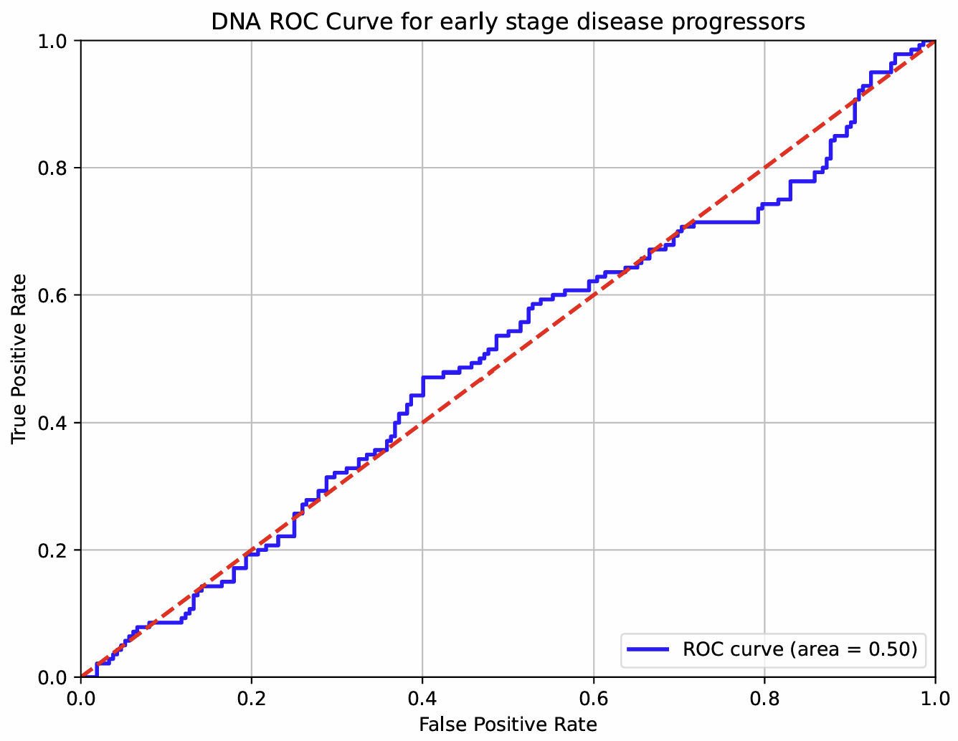
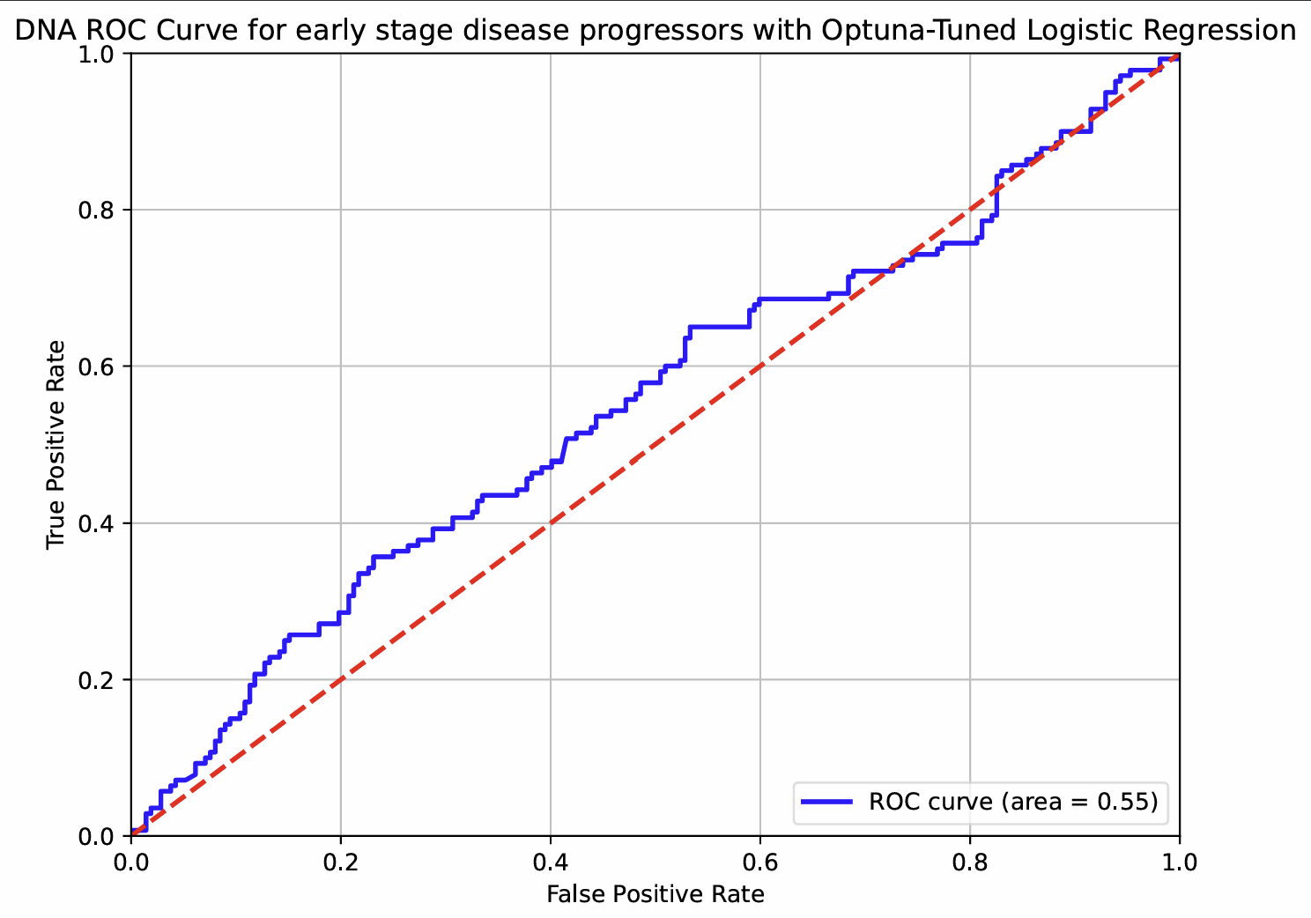
Dfs early-stage DNA roc curve
Notes:
- No to figure

Slide 8
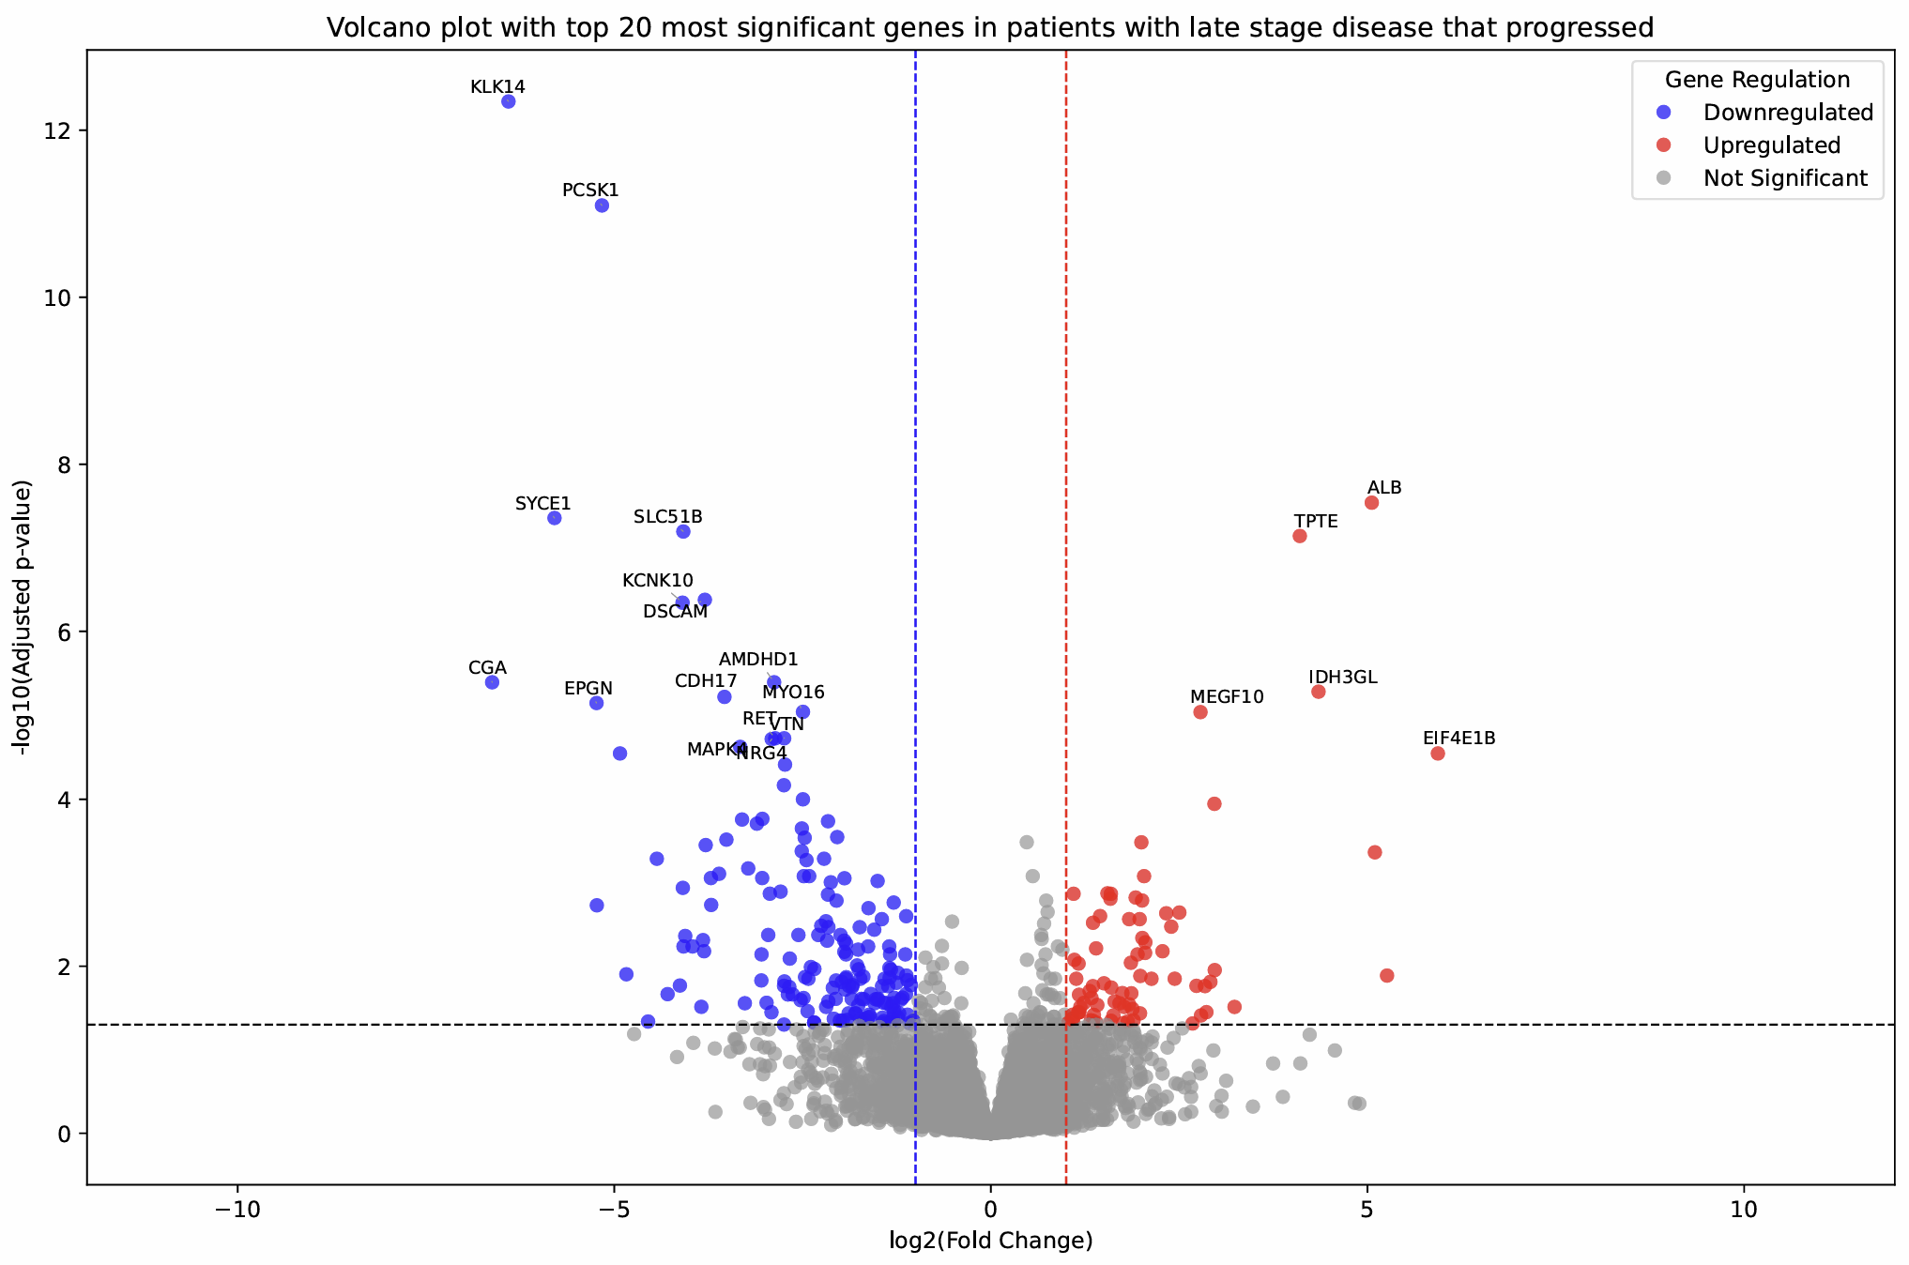
Dfs late-stage volcano
Notes:
- No to figure

Slide 9
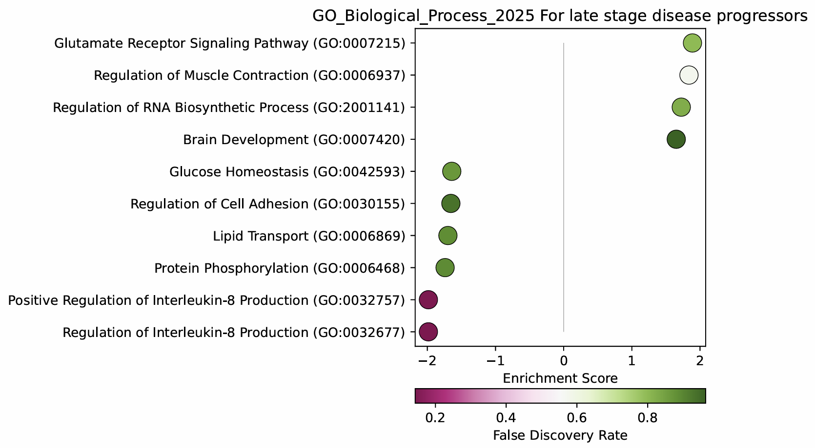
Dfs late-stage GO_bp GSEA
Notes:
- Yes to figure

Slide 10
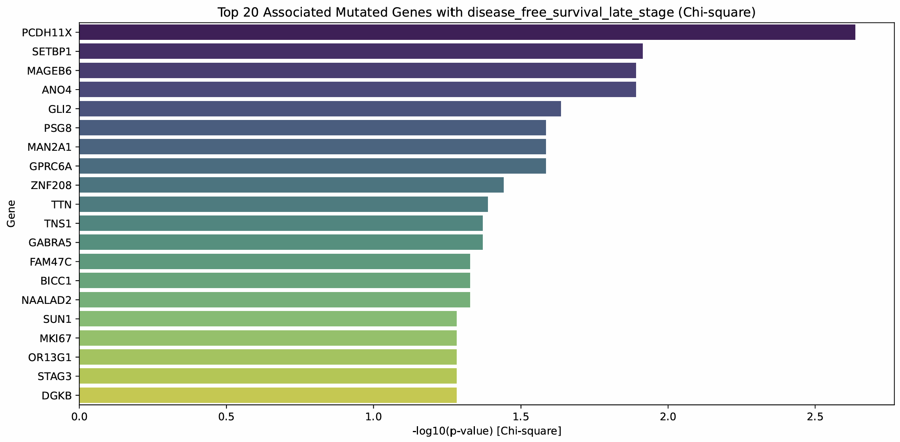
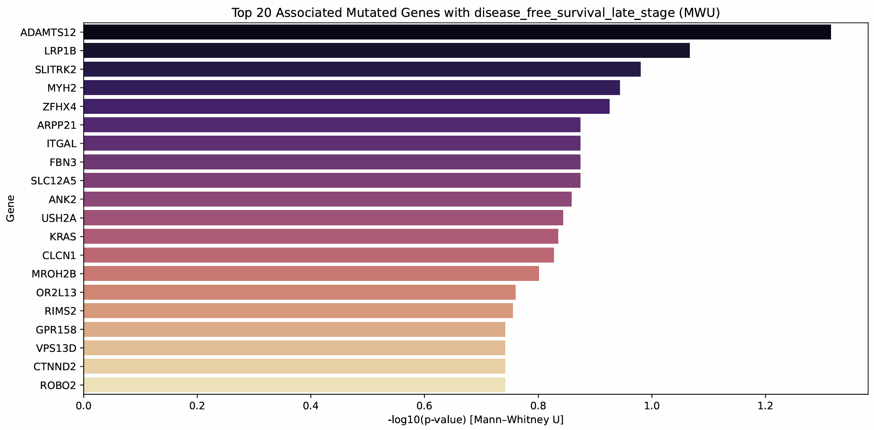
Dfs late-stage co-mutations
Notes:
- Appendix

Slide 11
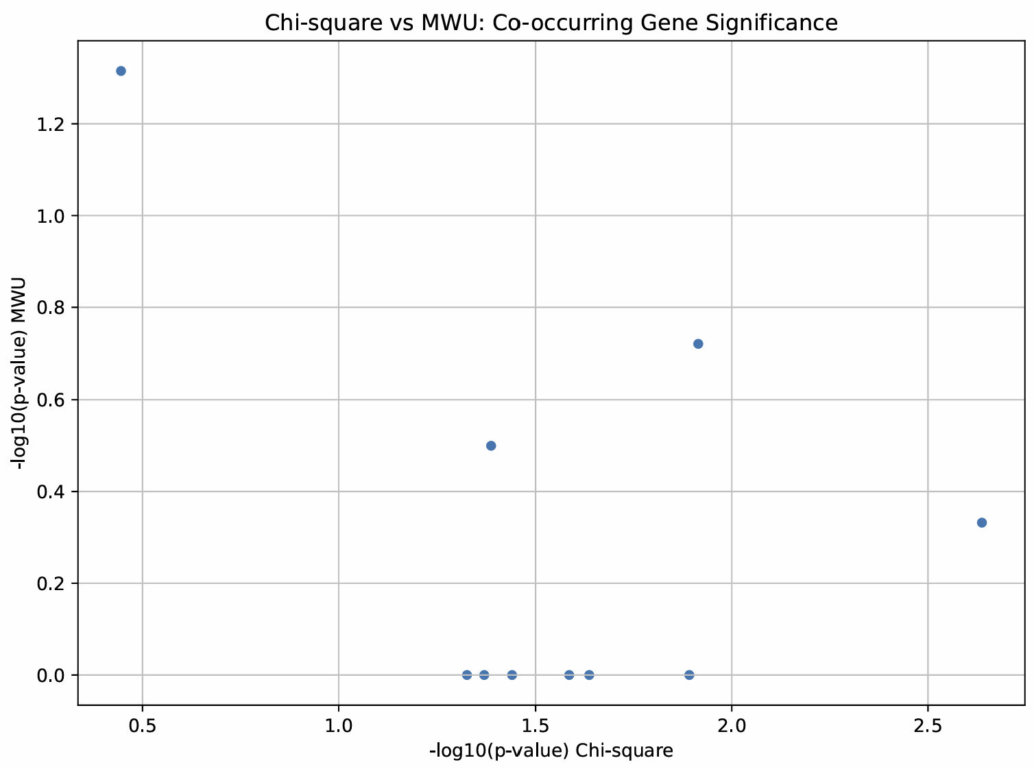
Dfs late-stage co-mutation scatter
Notes:
- No

Slide 12
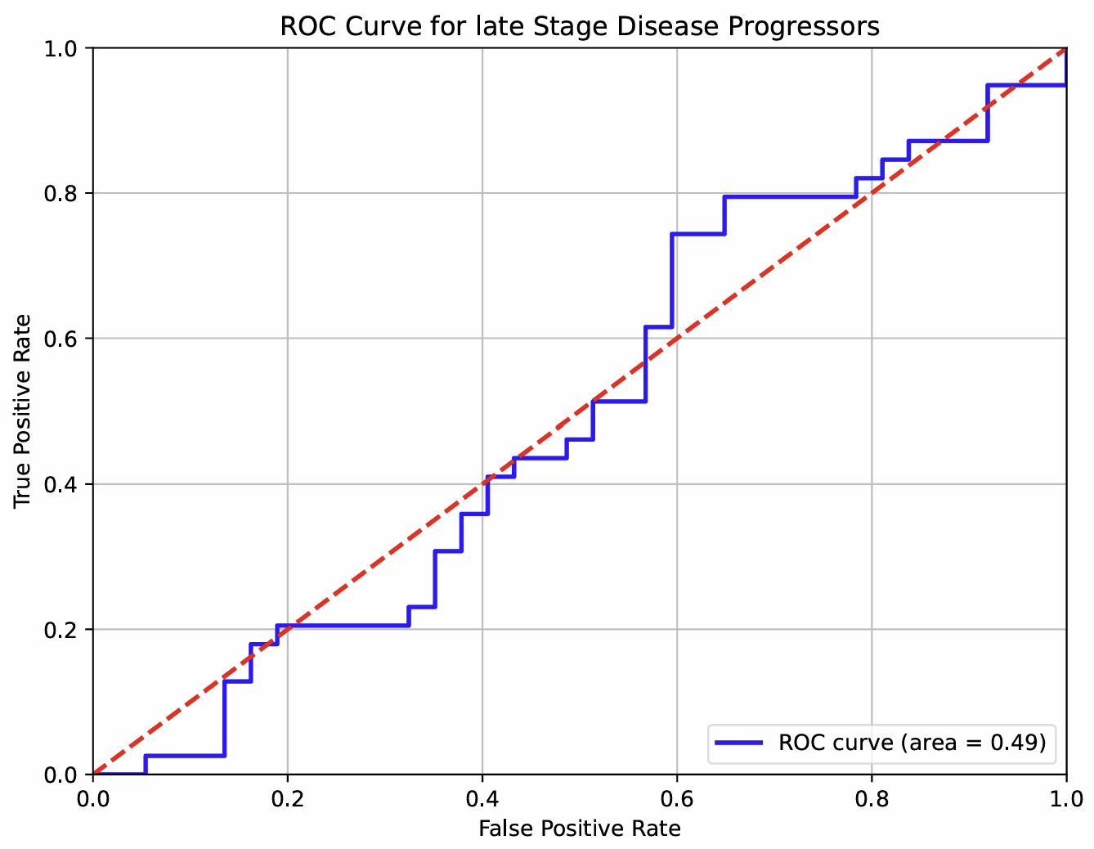
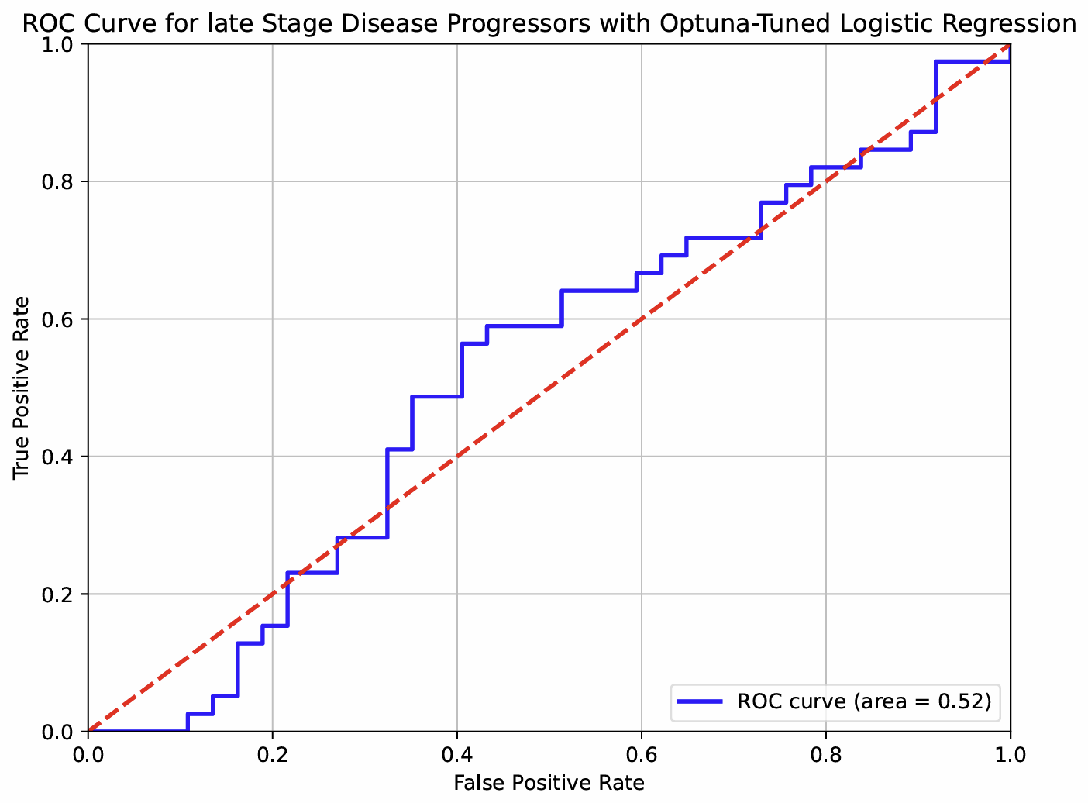
Dfs late-stage roc curve
Notes:
- Table only

Slide 13
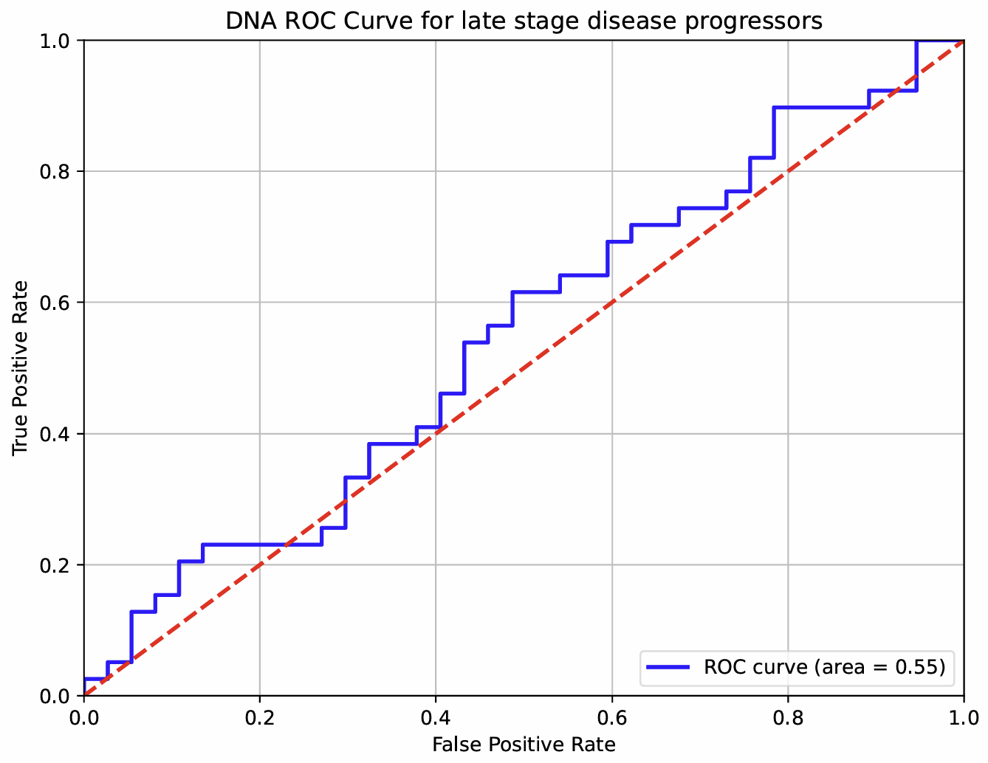
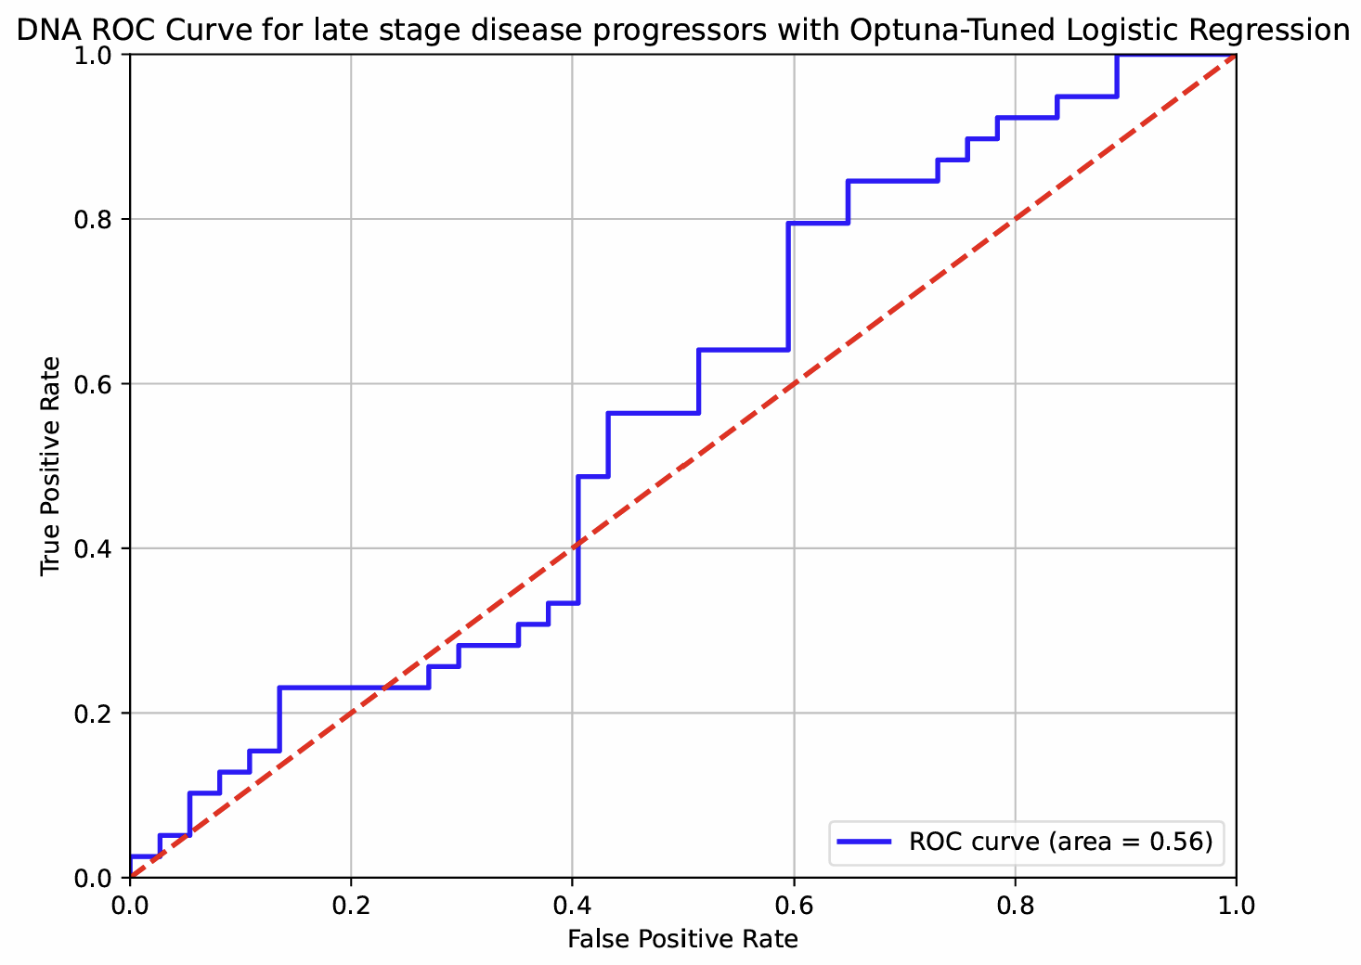
Dfs late-stage DNA roc curve
Notes:
- Table only

Slide 14
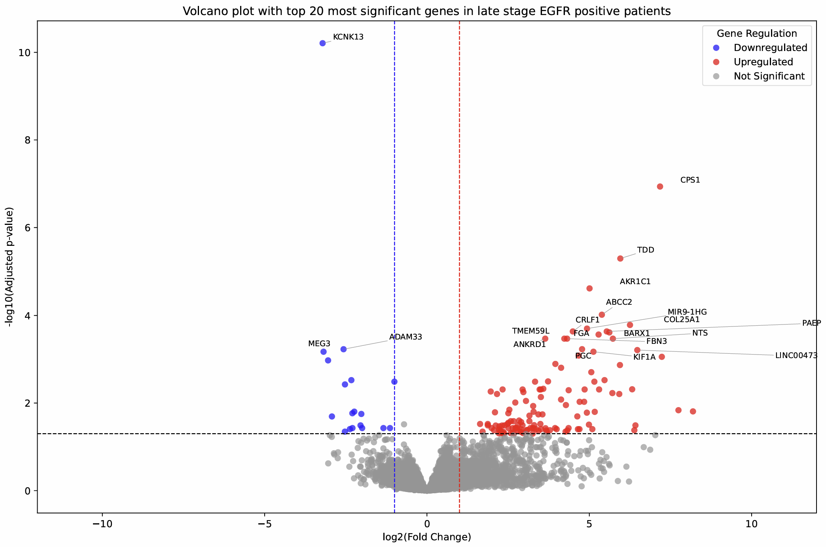
EGFR late-stage volcano
Notes:
- Yes (CPS1)

Slide 15
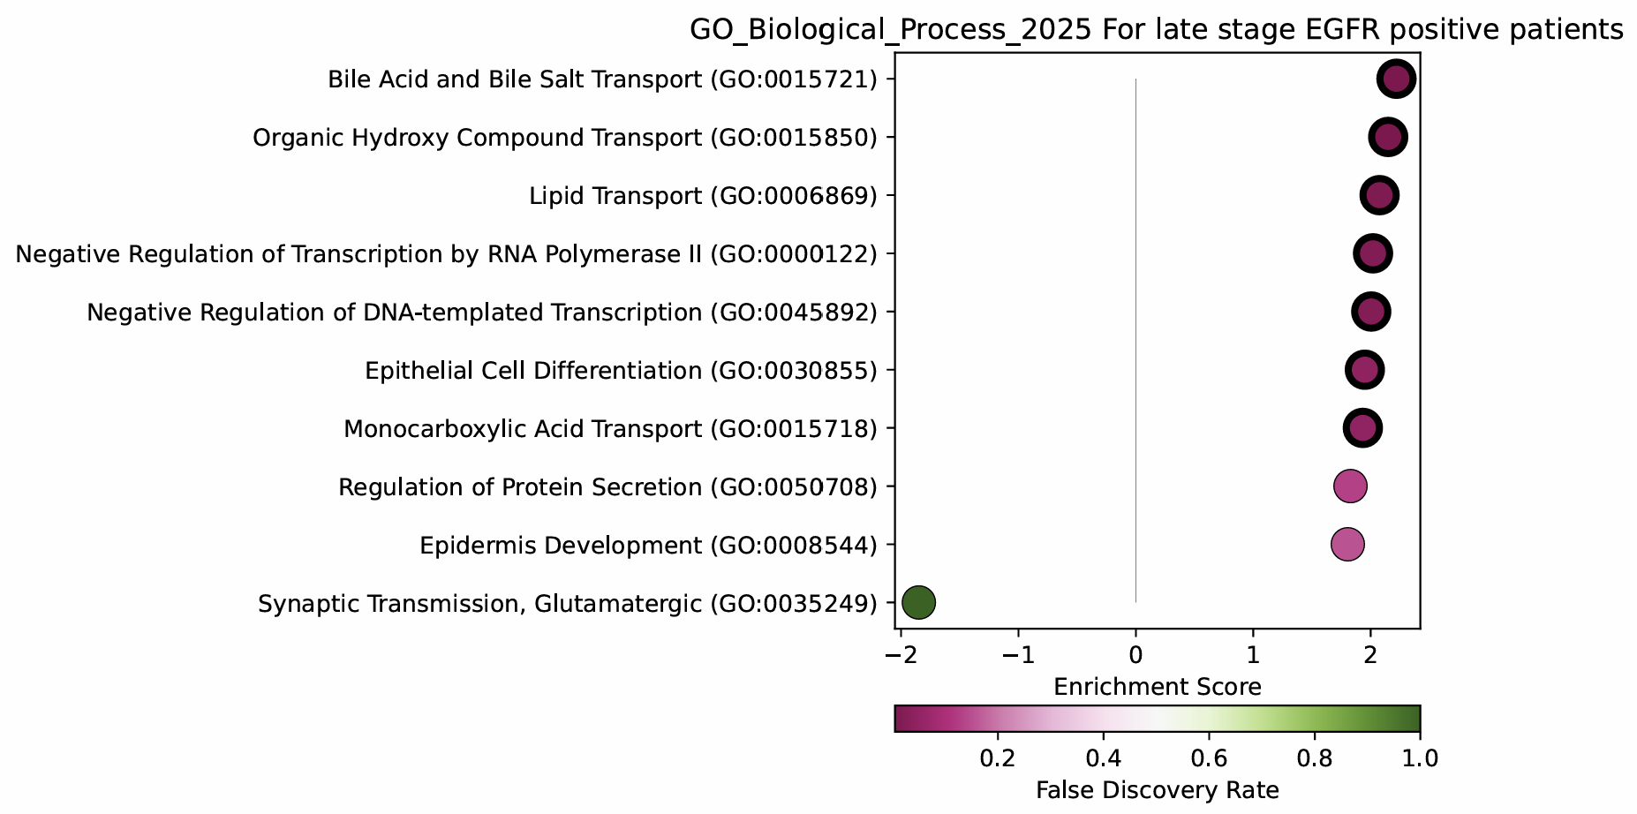
EGFR late-stage GO_bp GSEA
Notes:
- Yes (most important)

Slide 16
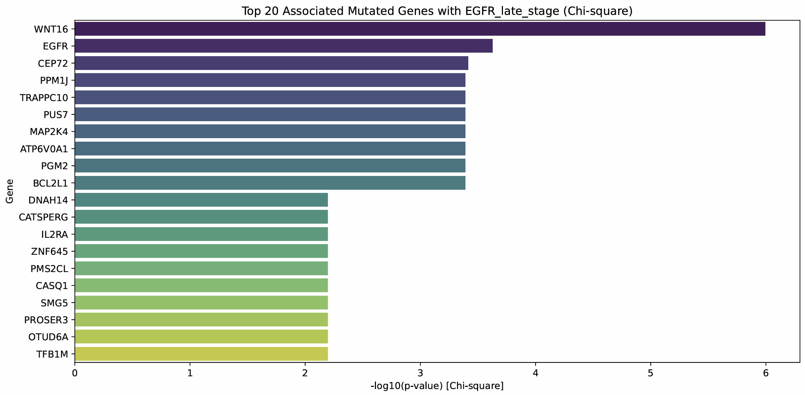
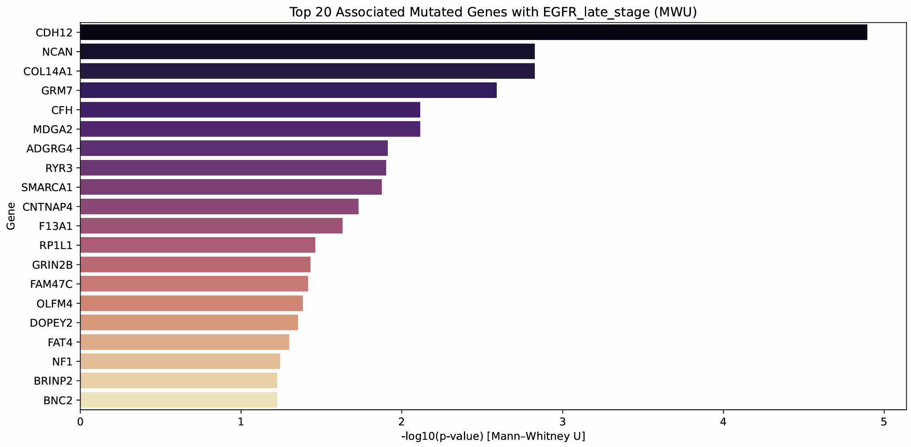
EGFR late-stage co-mutations
Notes:
- Yes

Slide 17
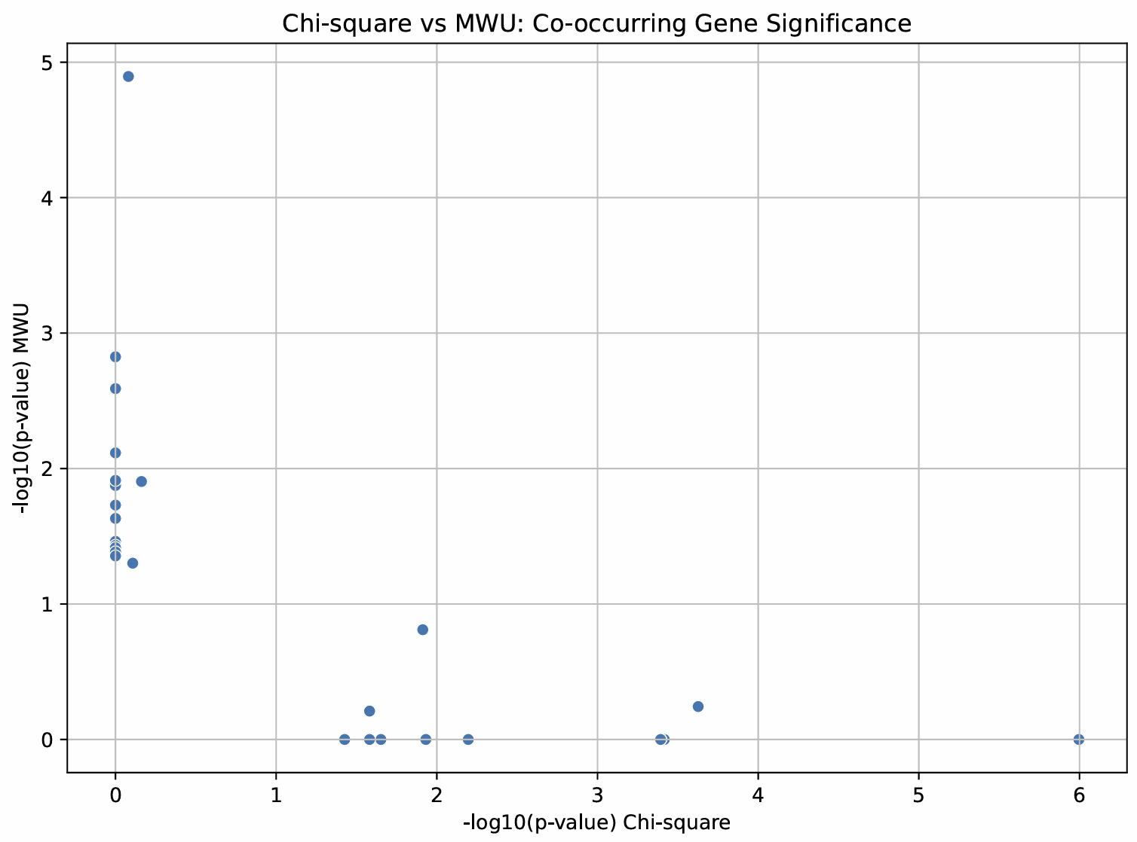
EGFR late-stage co-mutation scatter
Notes:
- No

Slide 18
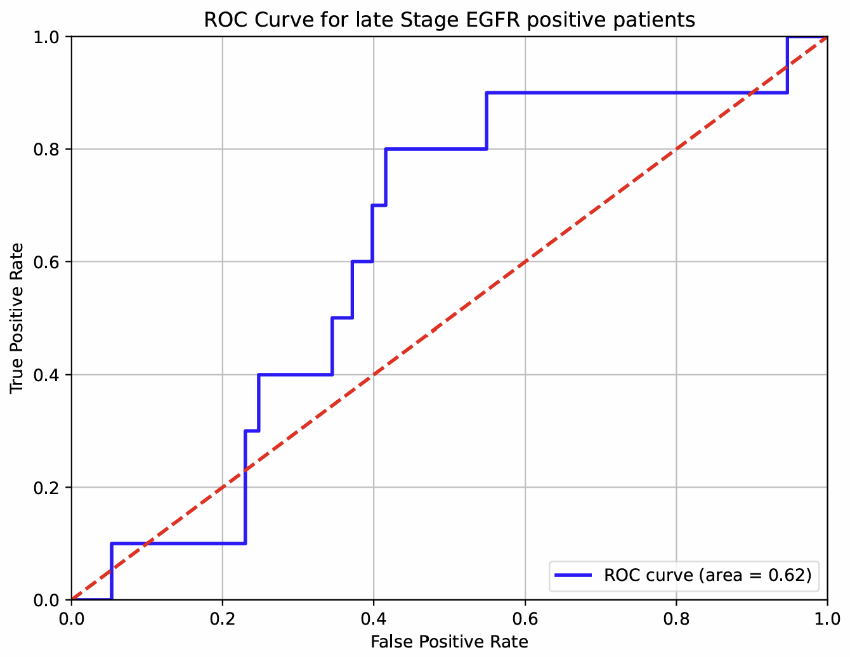
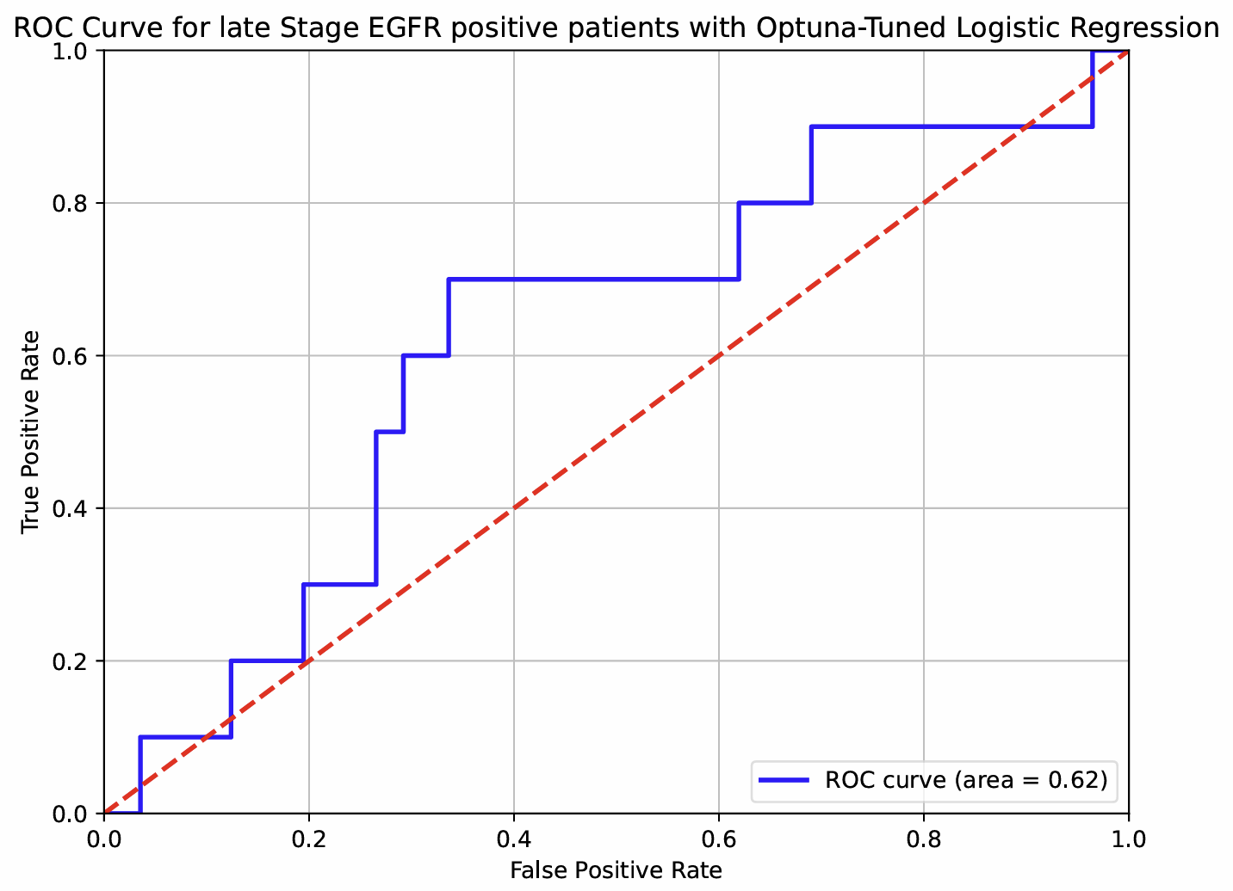
EGFR late-stage roc curve
Notes:
- Yes

Slide 19
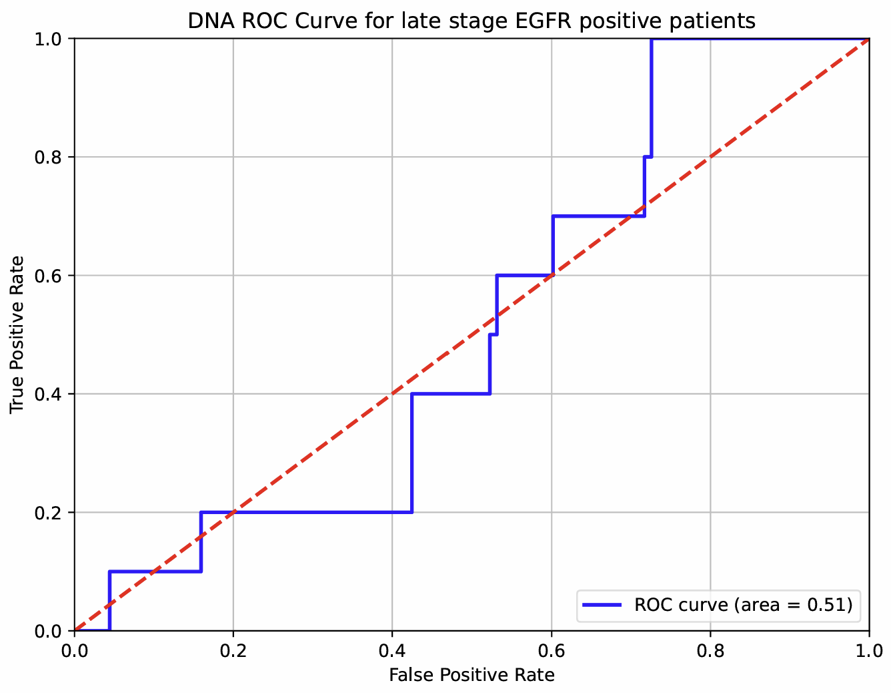
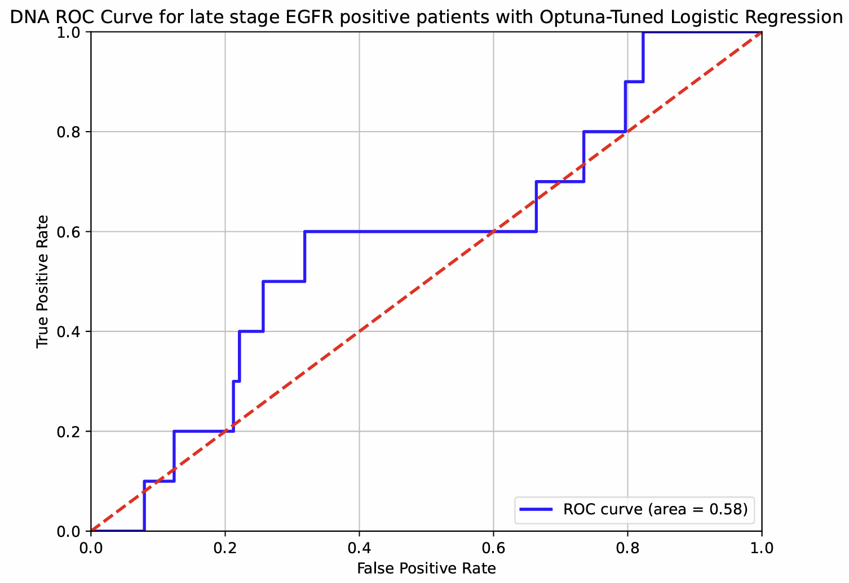
EGFR late-stage DNA roc curve
Notes:
- No, table only

Slide 20
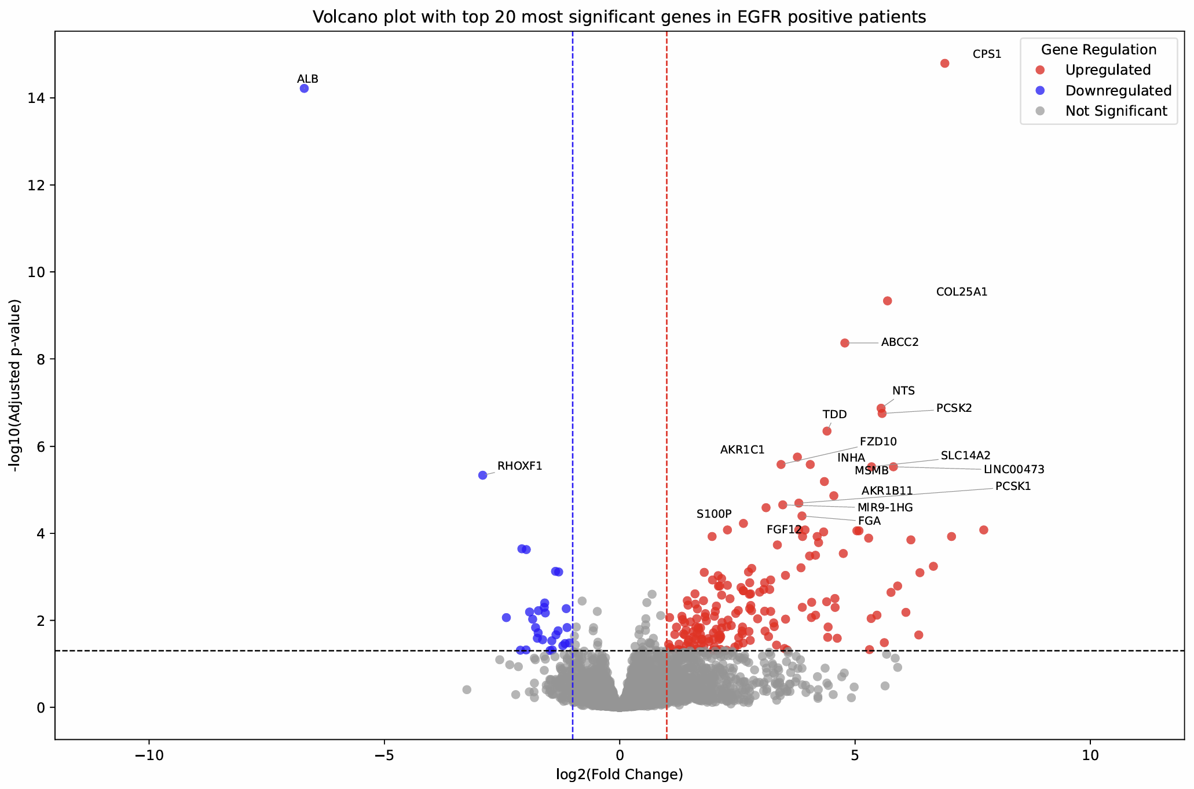
EGFR whole cohort volcano
Notes:
- Yes

Slide 21
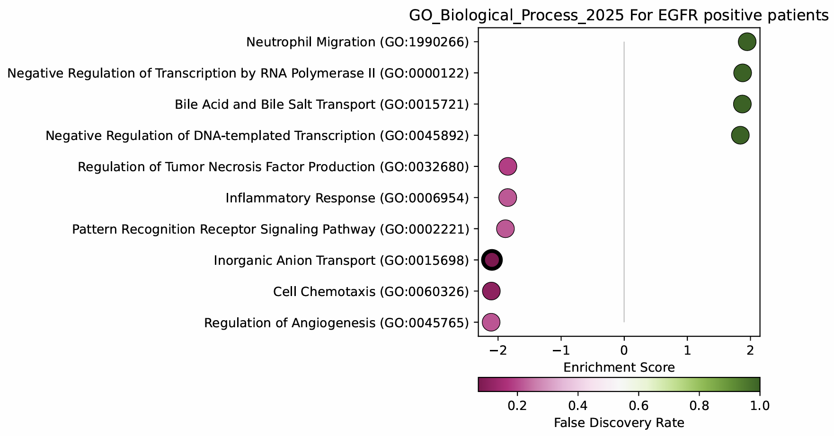
EGFR whole cohort GO_bp GSEA
Notes:
- Yes

Slide 22
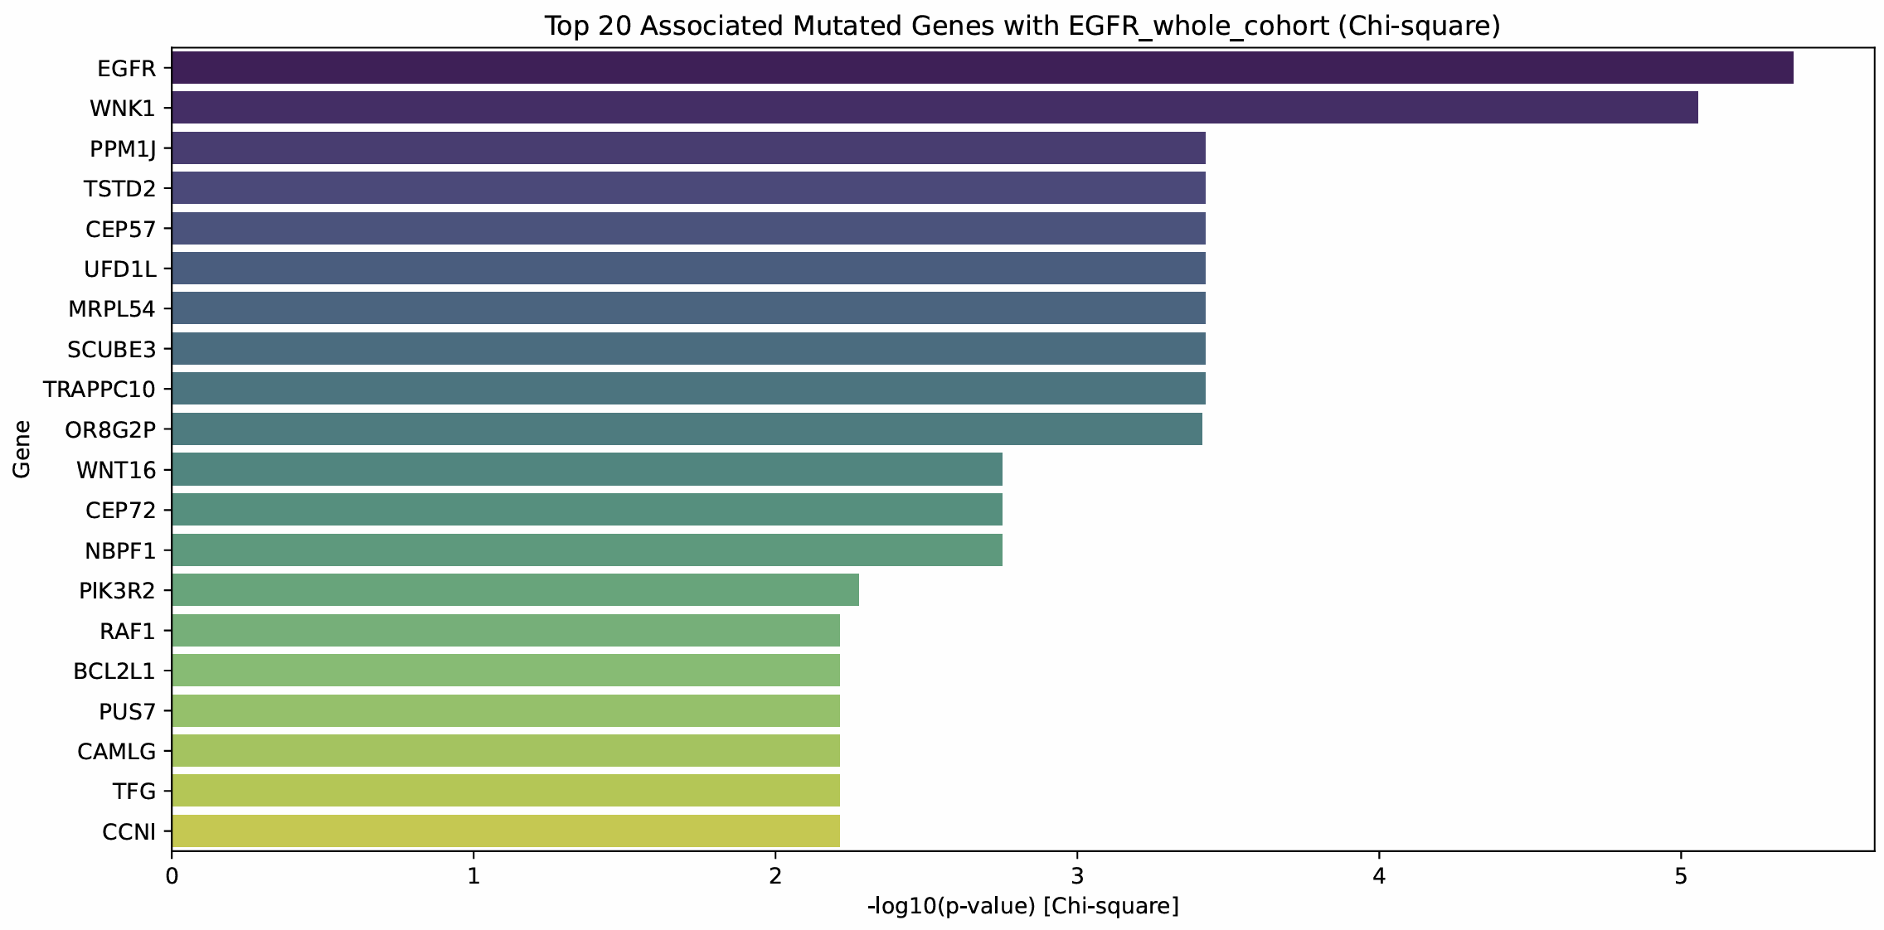
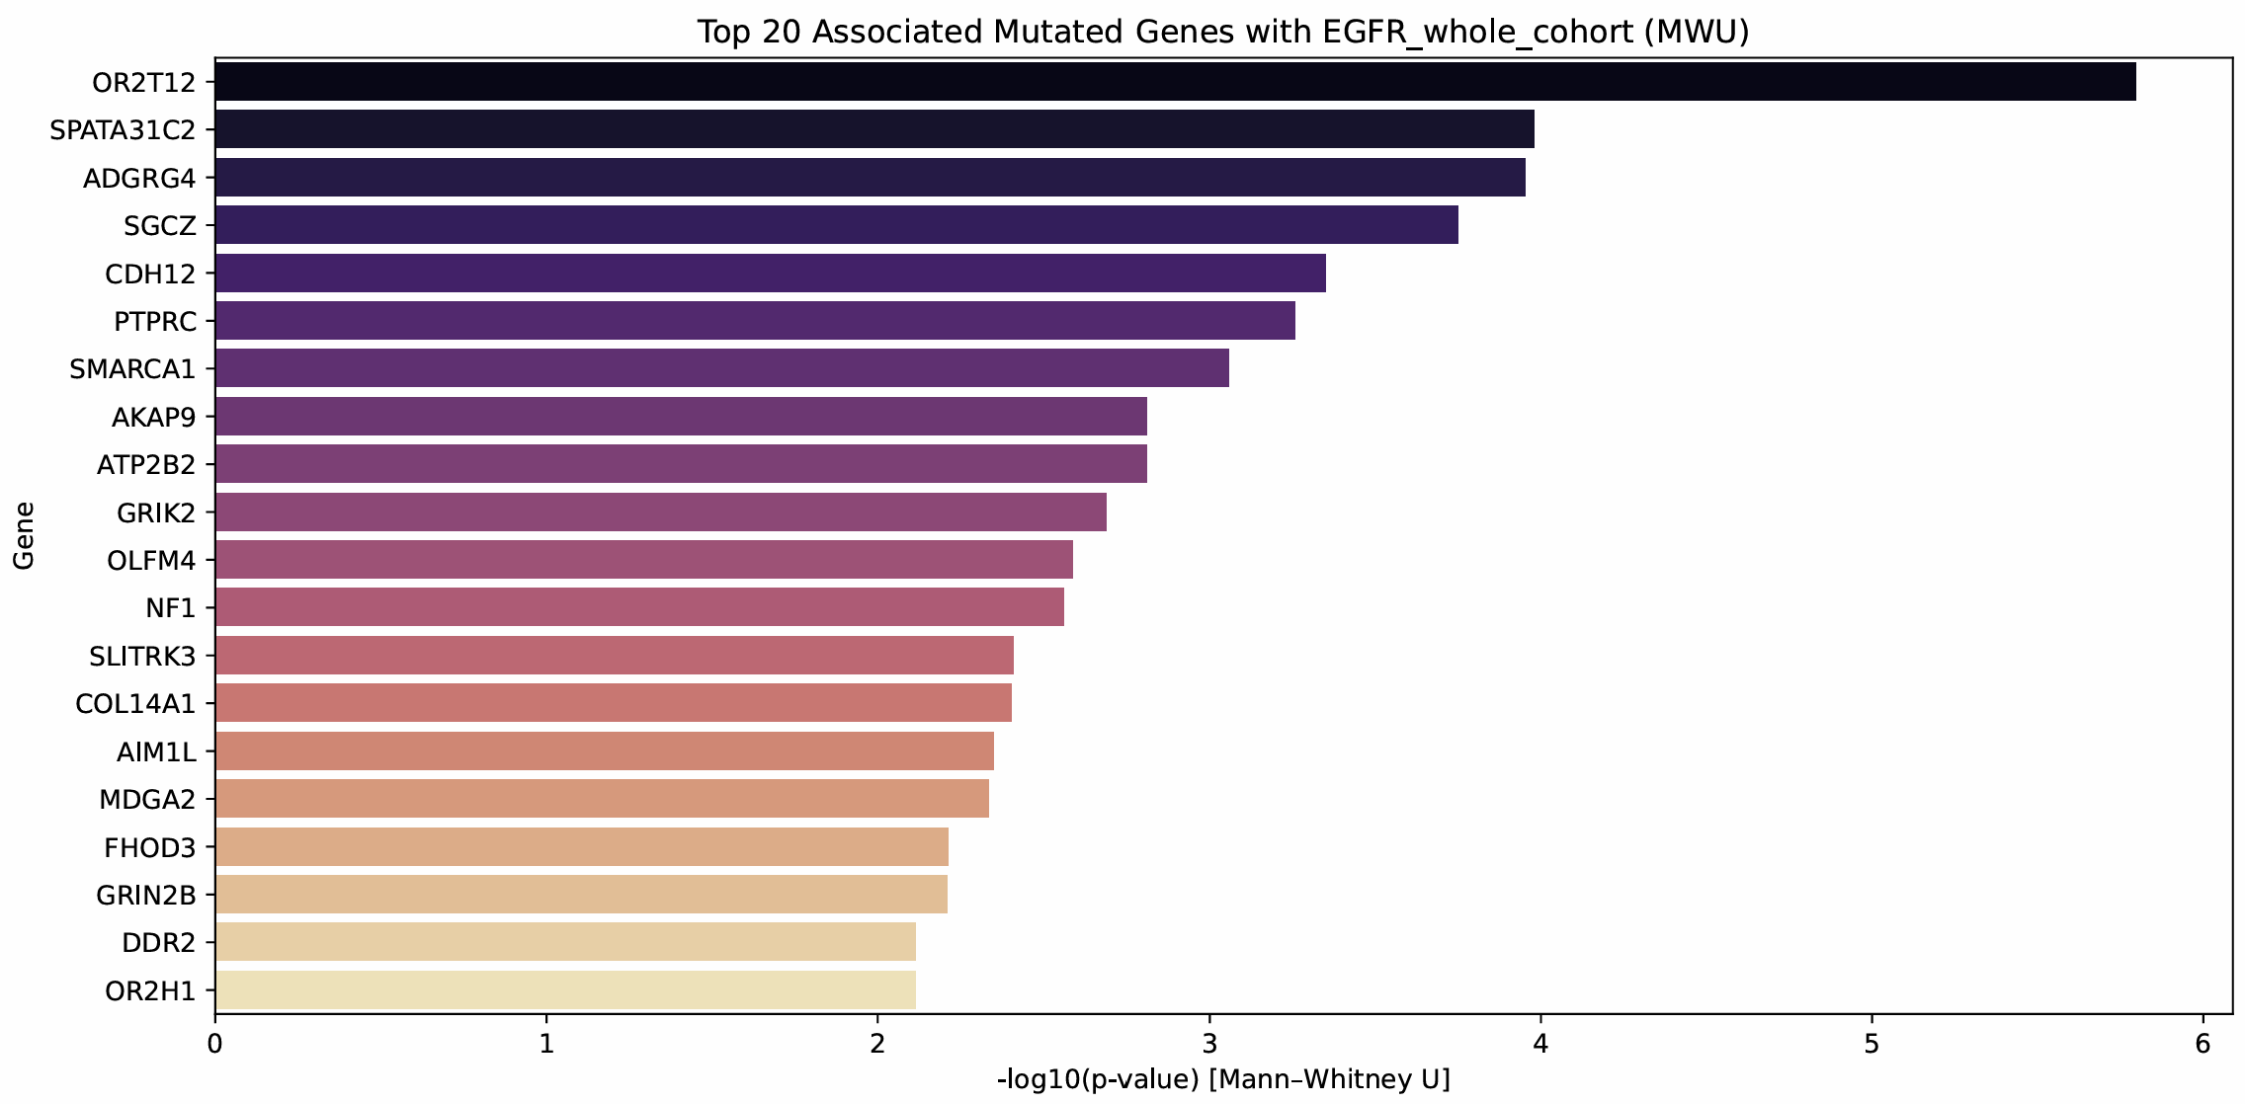
EGFR whole cohort co-mutations
Notes:
- Yes

Slide 23
EGFR whole cohort co-mutation scatter
Notes:
- No

Slide 24
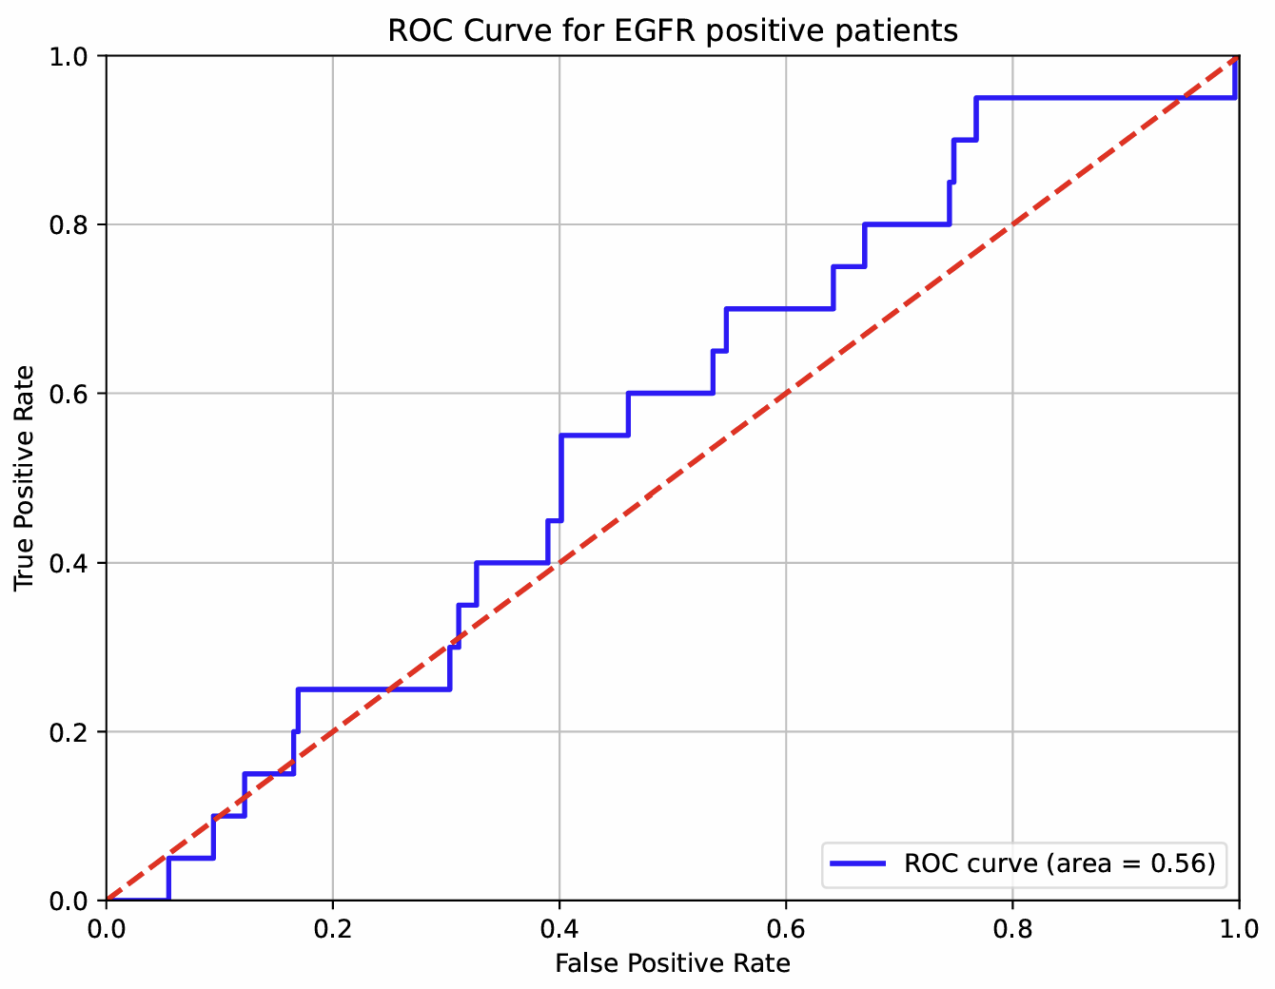
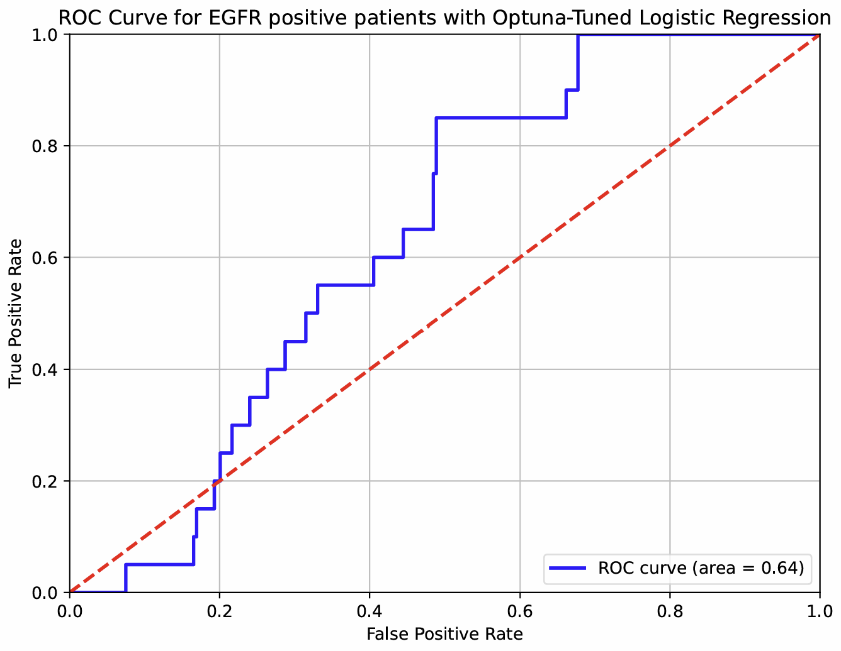
EGFR whole cohort roc curve
Notes:
- Yes

Slide 25
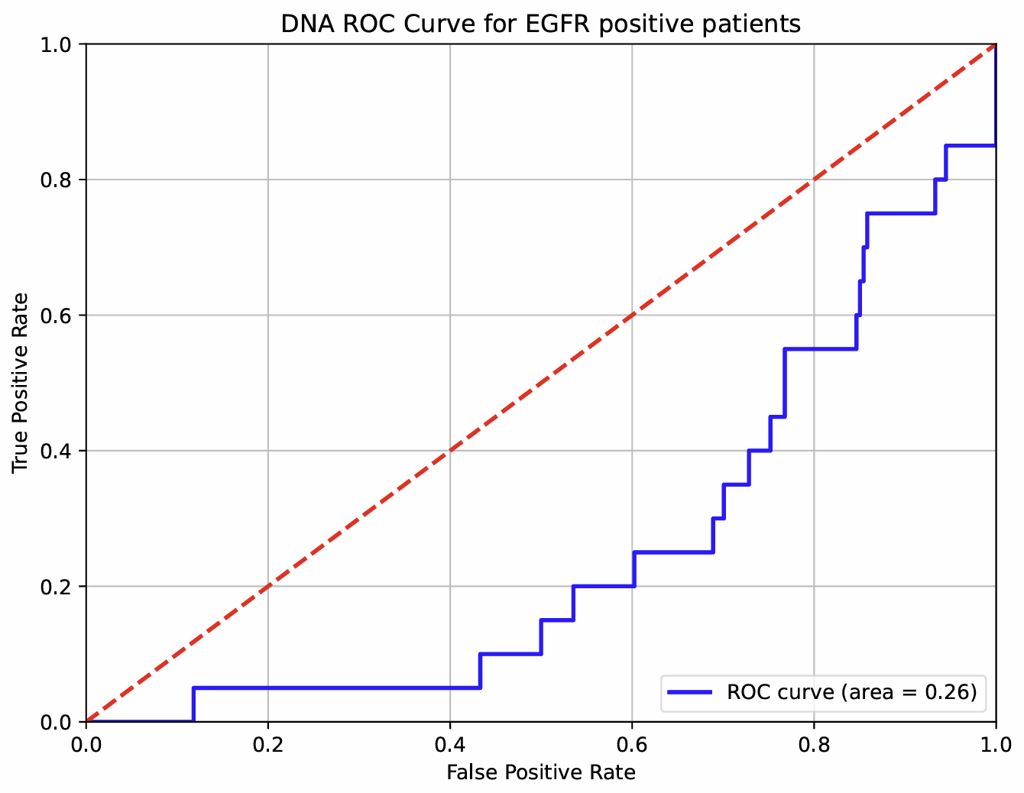
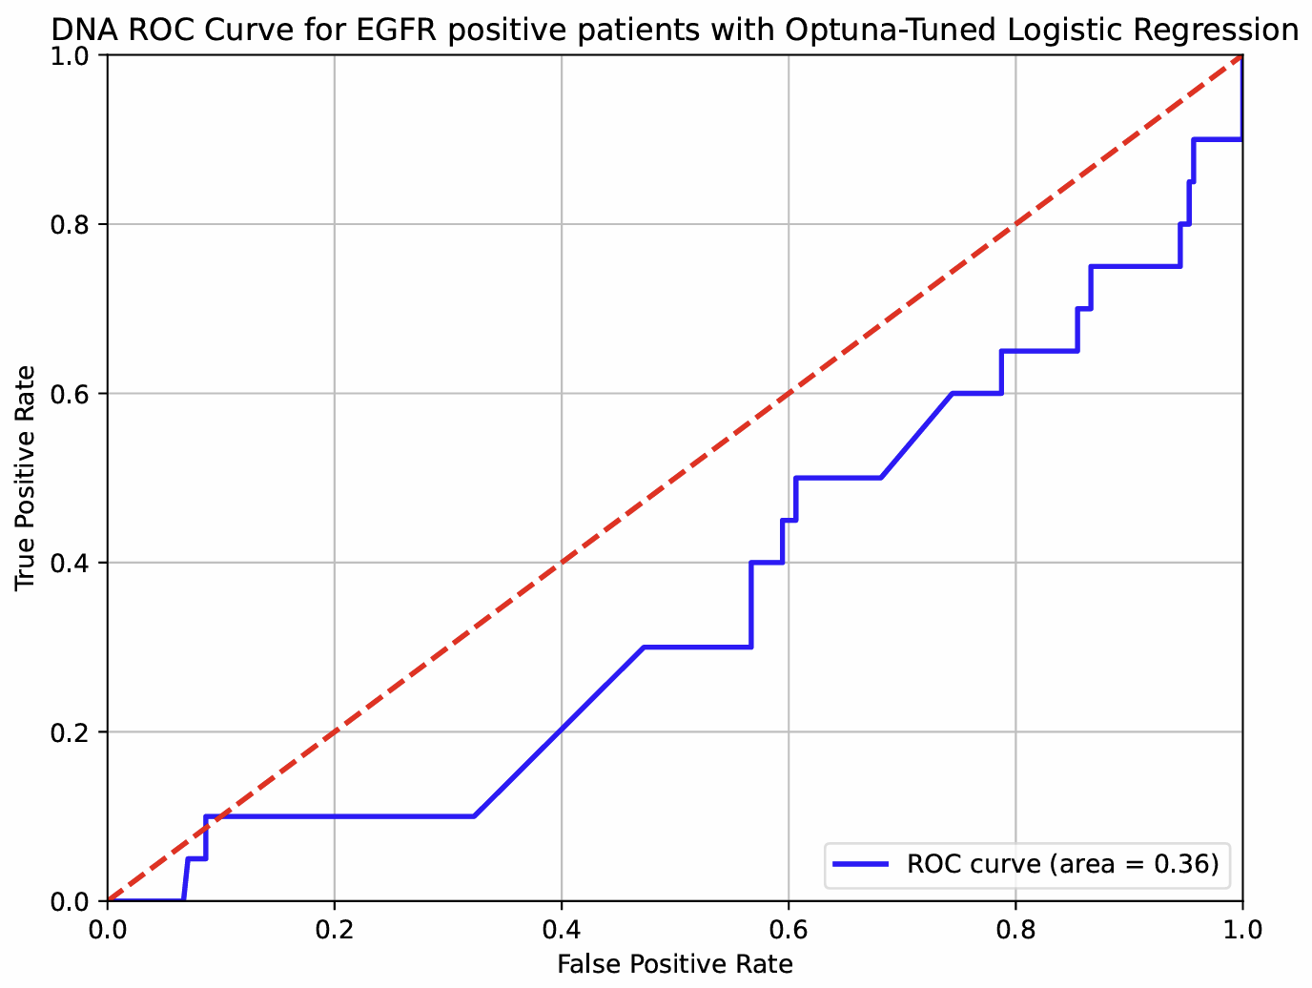
EGFR whole cohort DNA roc curve
Notes:
- No, table only

Slide 26
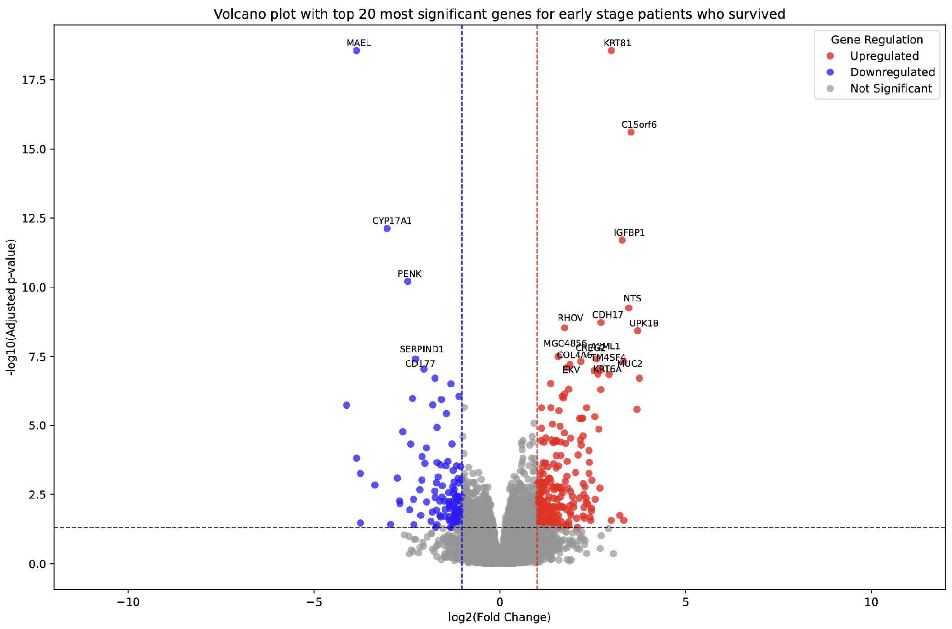
OS early-stage volcano
Notes:
- Appendix

Slide 27
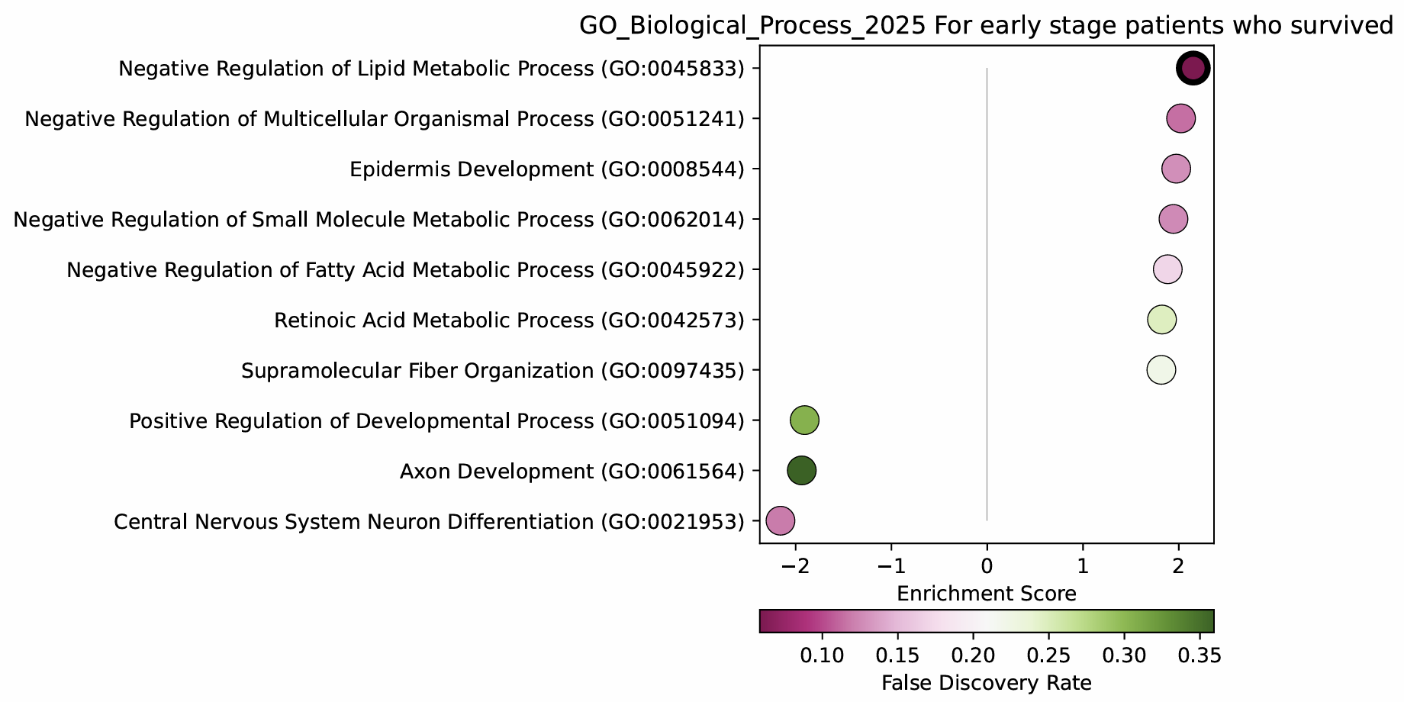
OS early-stage GO_bp GSEA
Notes:
- Yes

Slide 28
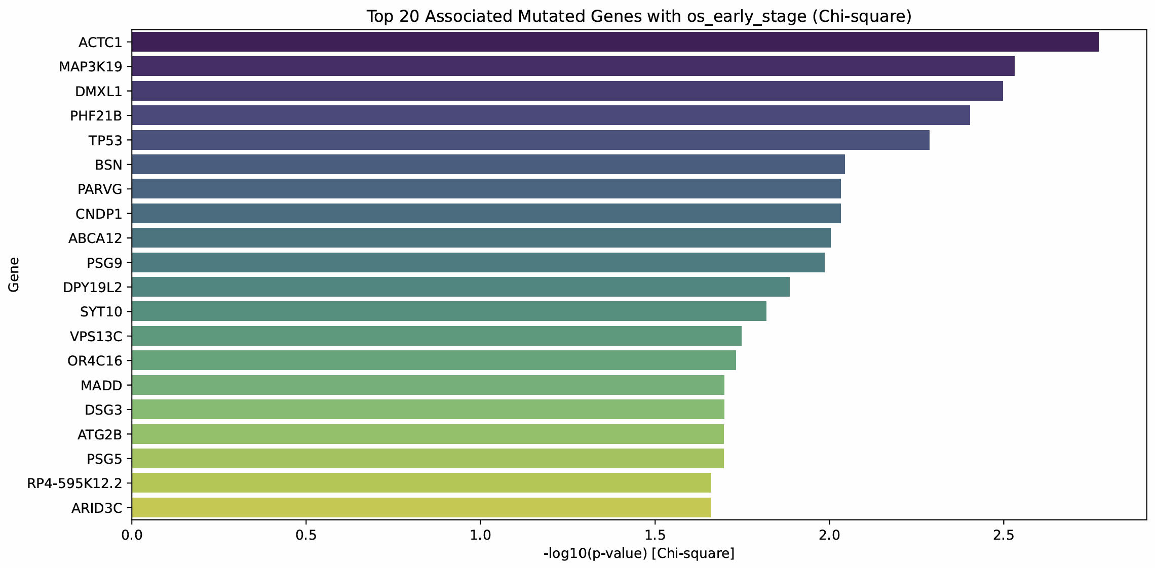
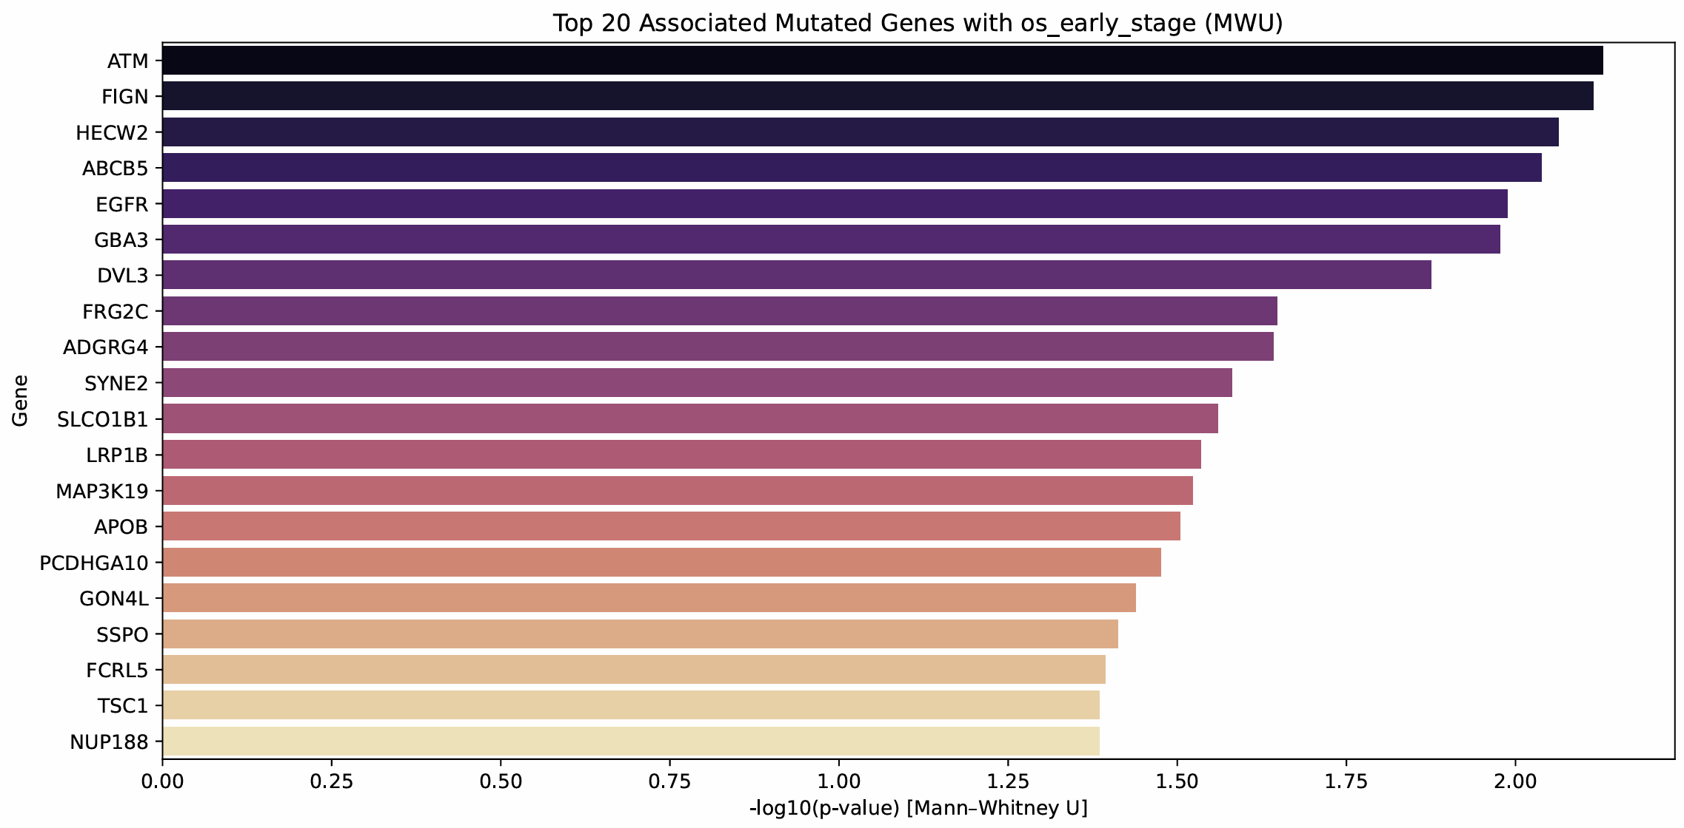
OS early-stage co-mutations
Notes:
- Appendix

Slide 29
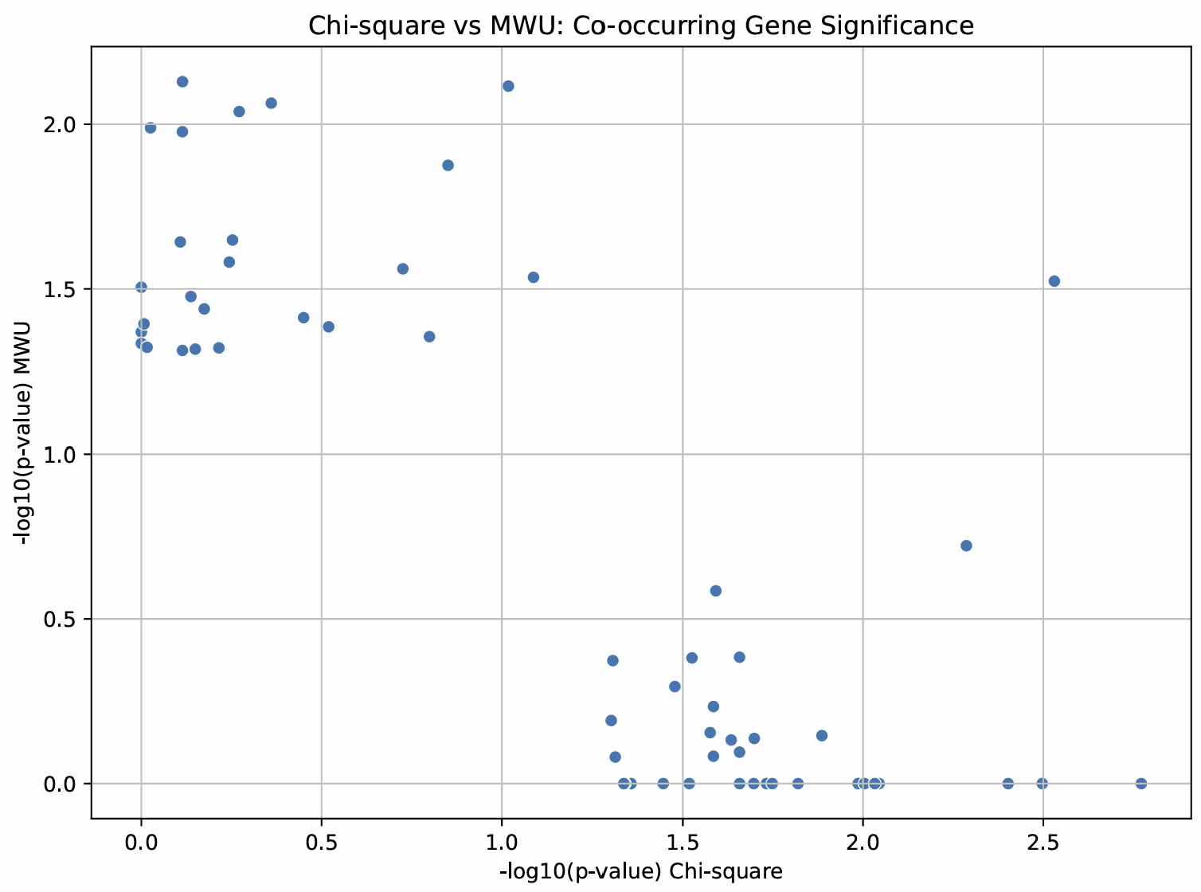
OS early-stage co-mutation scatter
Notes:
- No

Slide 30
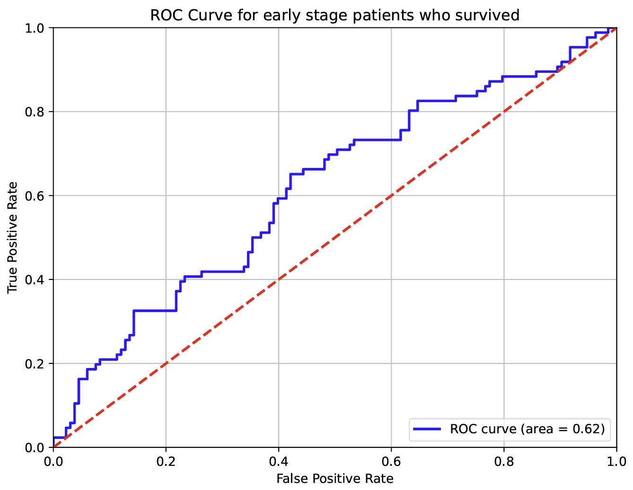
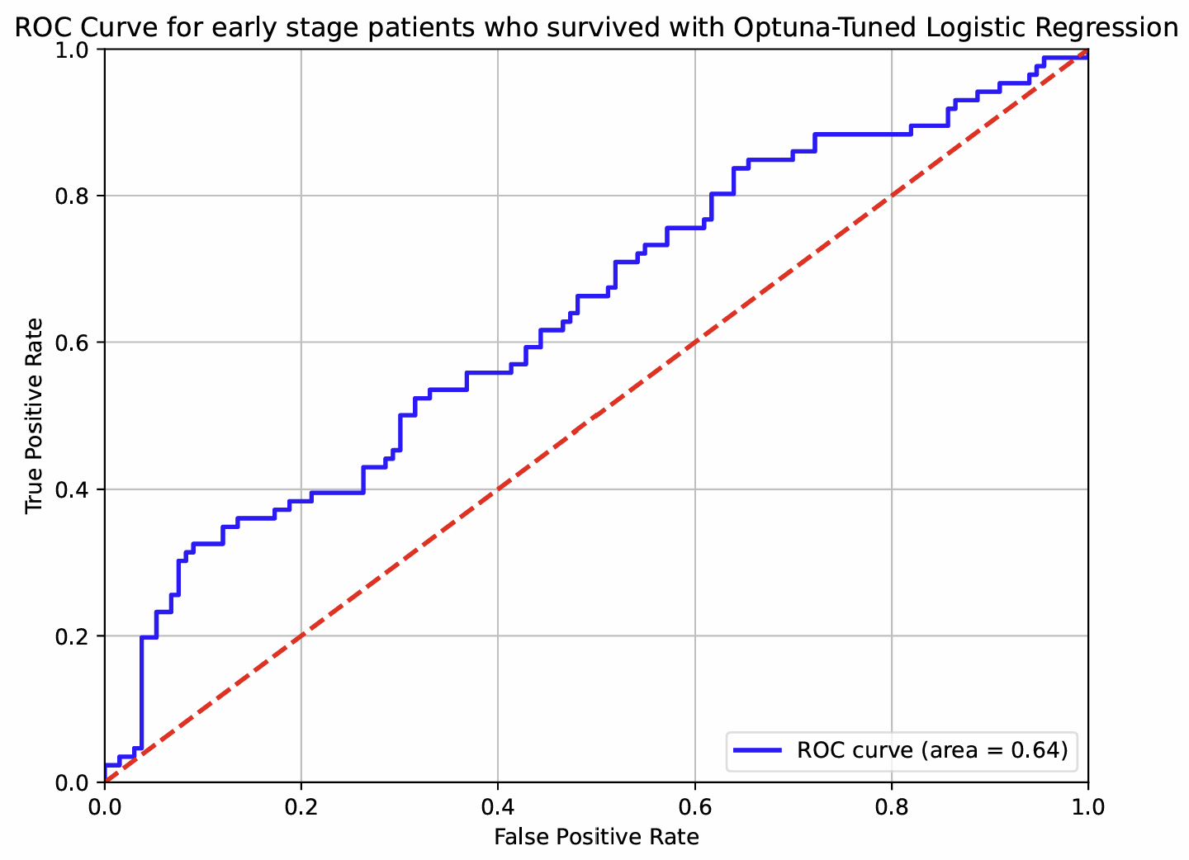
OS early-stage roc curve
Notes:
- Yes

Slide 31
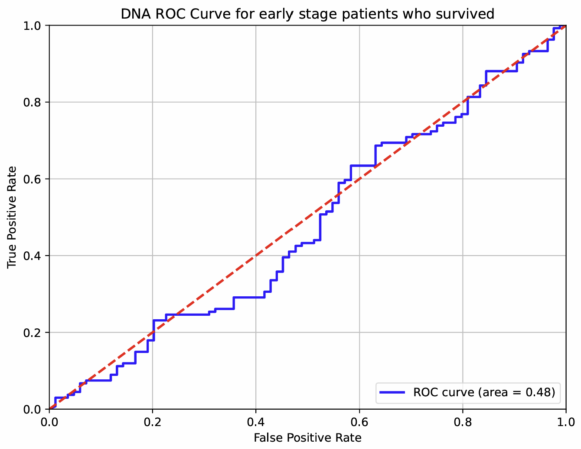
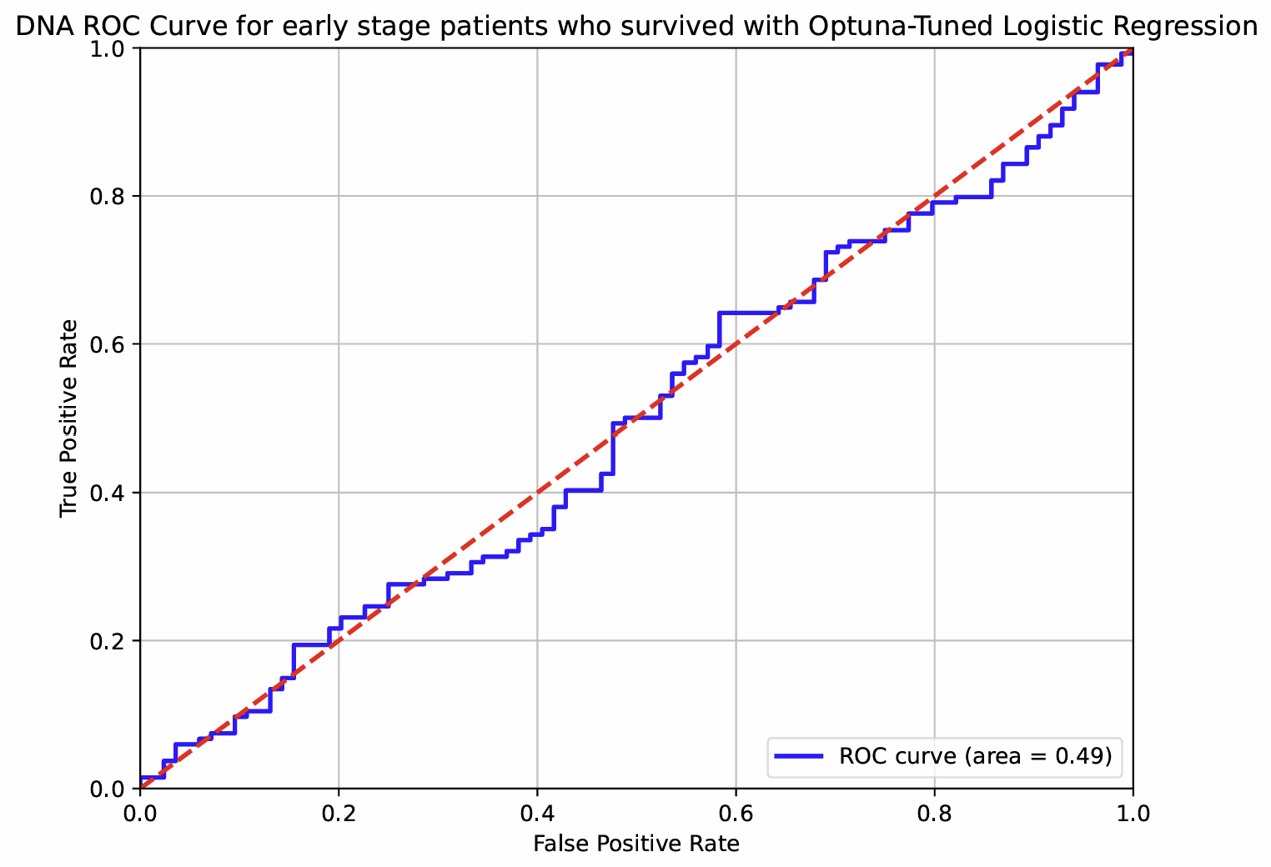
OS early-stage DNA roc curve
Notes:
- No, table only

Slide 32
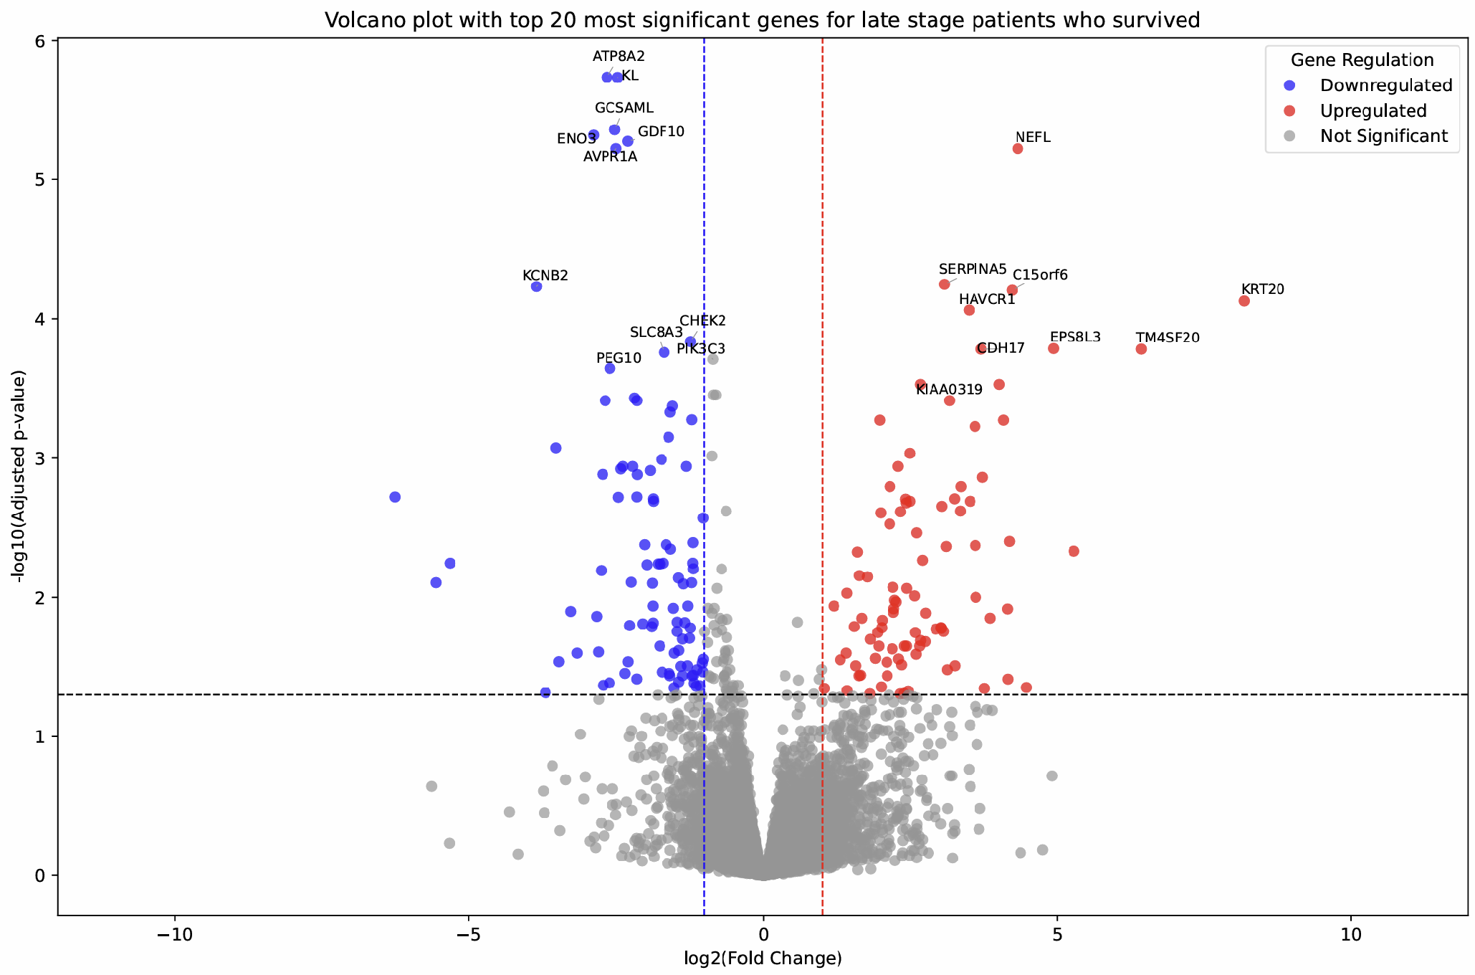
OS late-stage volcano
Notes:
- Appendix

Slide 33
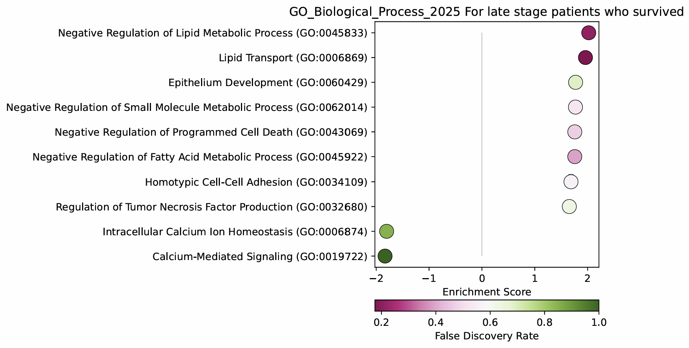
OS late-stage GO_bp GSEA
Notes:
- Yes

Slide 34
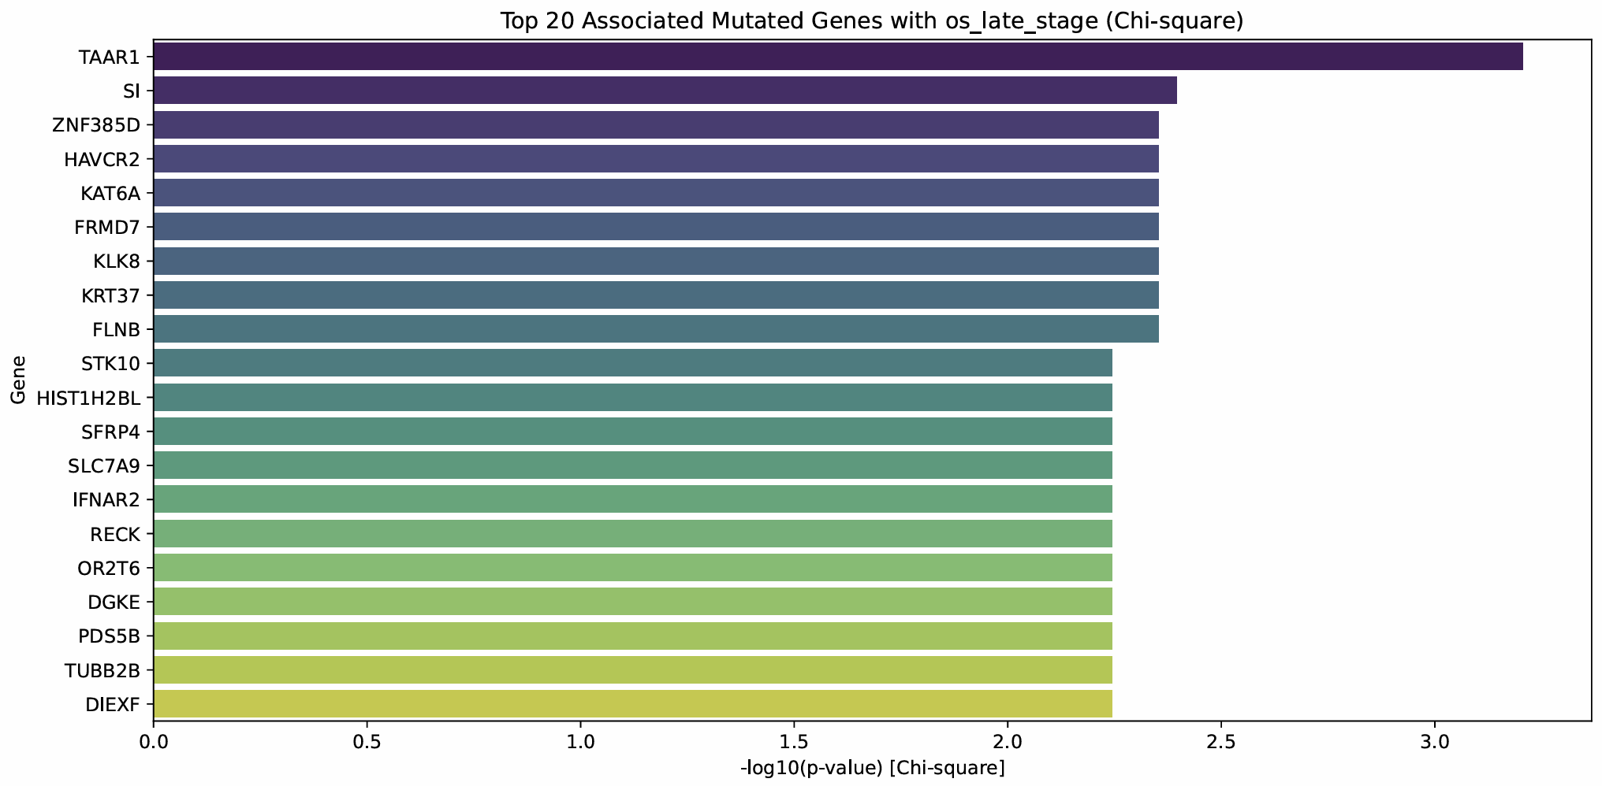
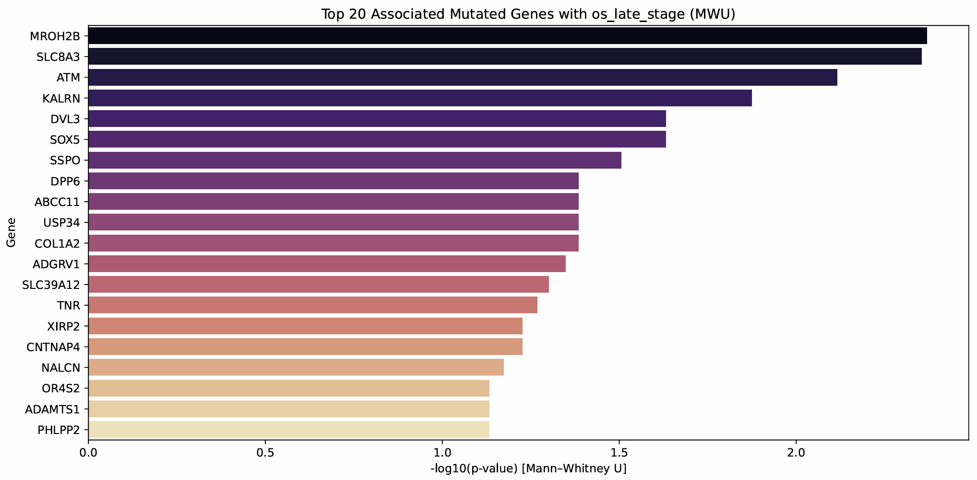
OS late-stage co-mutations
Notes:
- Appendix

Slide 35
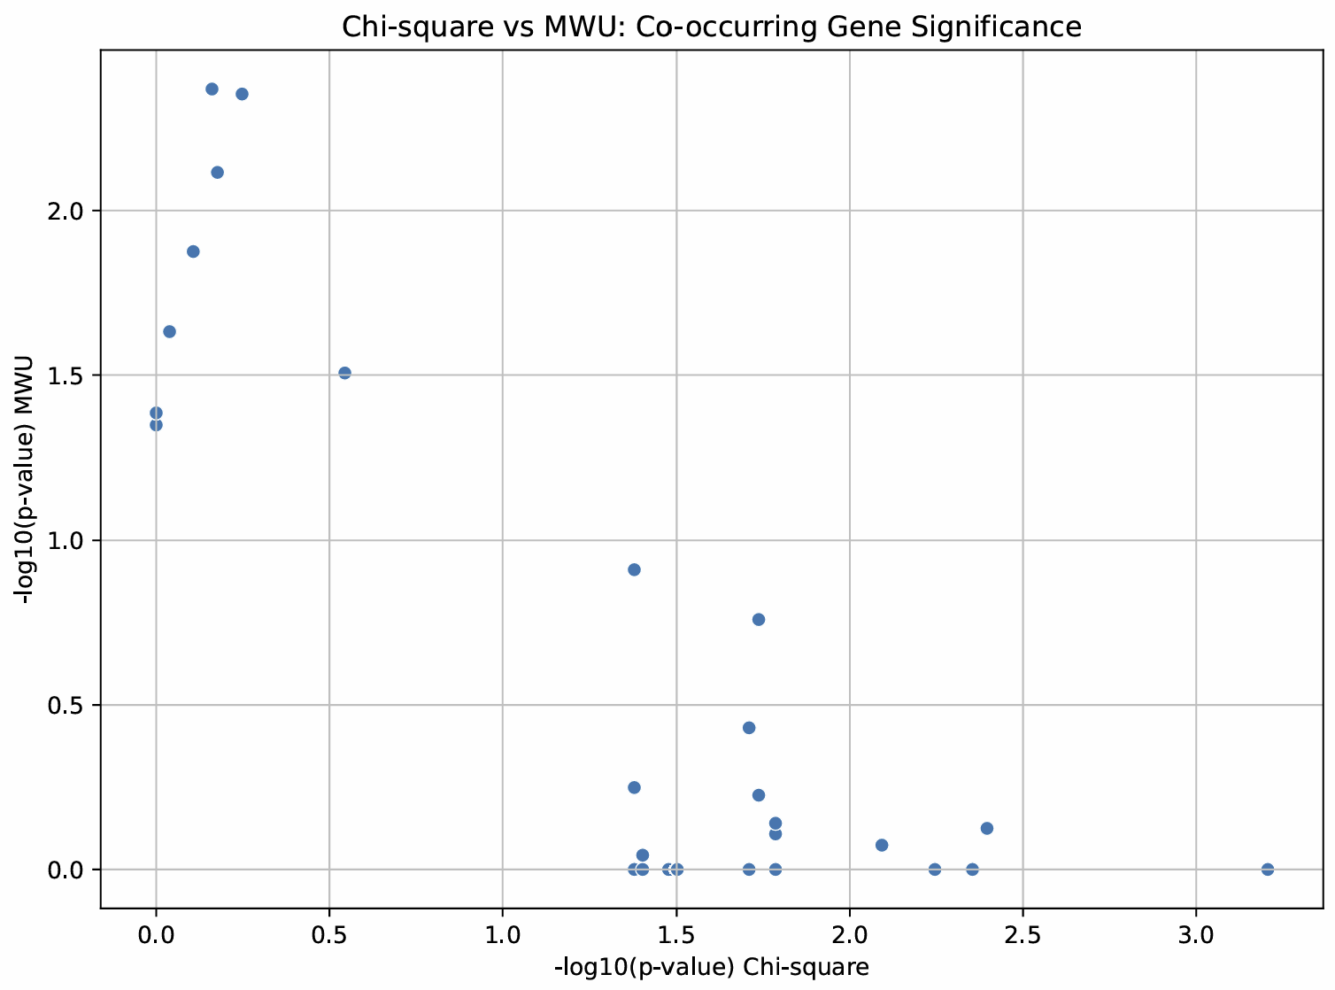
OS late-stage co-mutation scatter
Notes:
- No

Slide 36
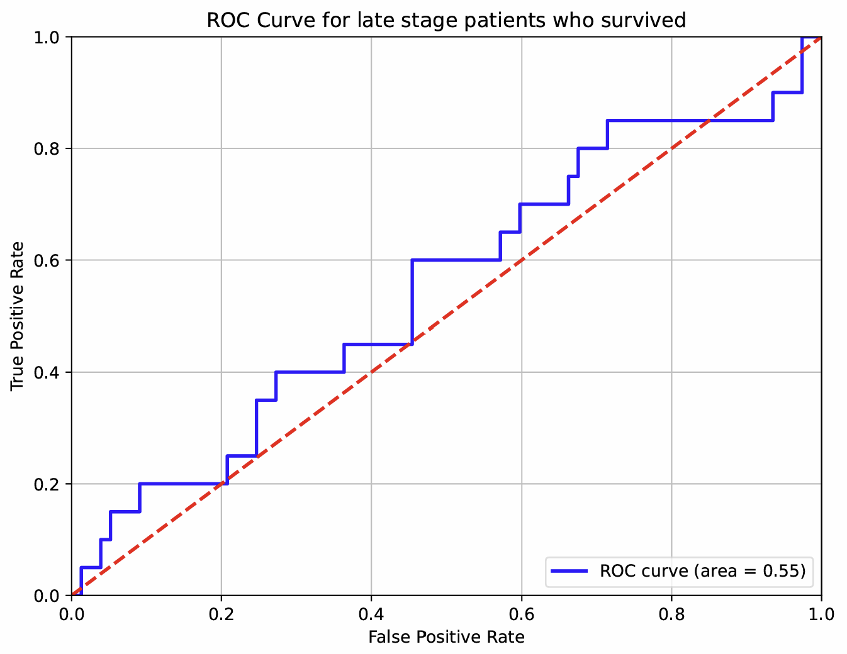

OS late-stage roc curve
Notes:
- Yes

Slide 37


OS late-stage DNA roc curve
Notes:
- No, table only

